Slide 1
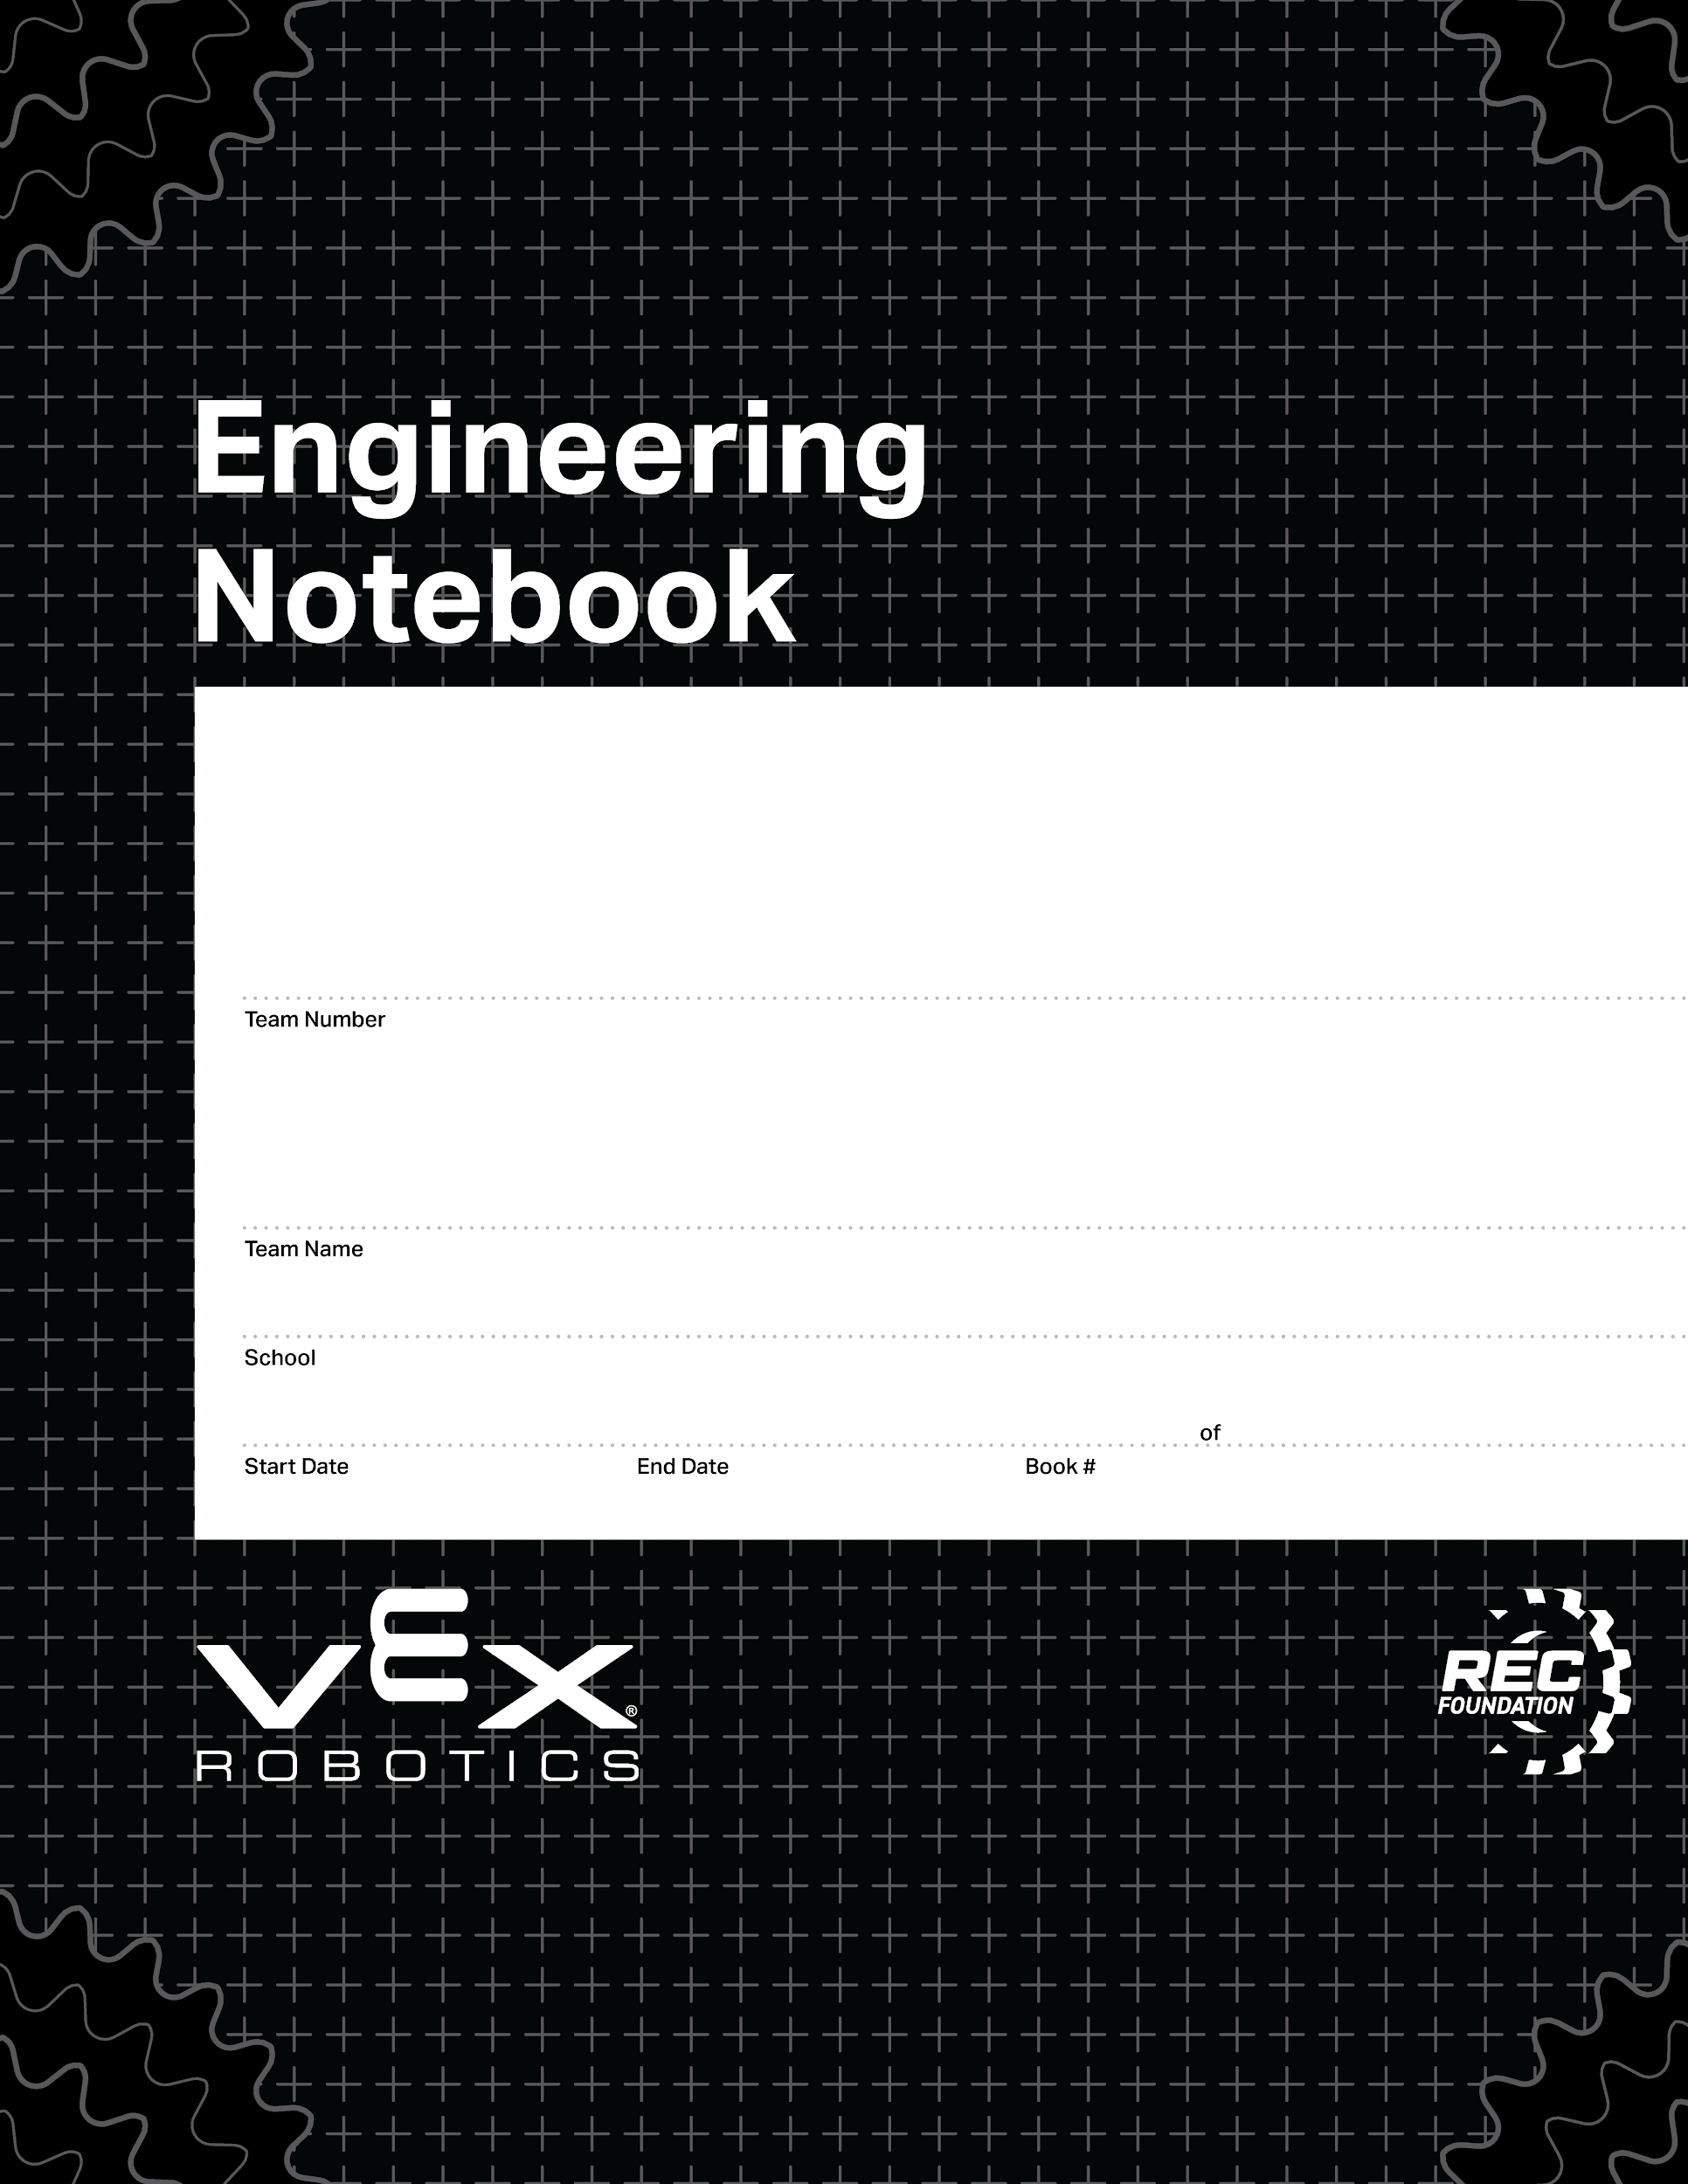
0040
Albuquerque Quesadillas
Colorado Early Colleges Windsor
08/27/2024
06/10/2024
1
1
V3.0 Date 6.10.24

Slide 2
Notes
Review Notebook Rules 8/27/2024
Drawings
2. Original Base Drawing 8/27/2024
3. First Base Drawing 9/4/24
Second Base Drawing 9/5/24
First Conveyer Belt Drawing 8/29/24
Third Base Drawing 9/6/24
Brain Ports/ Controller Program and Game Map
7.
Scrum Notes/ Calendars
14. Product Backlog 8/28/2024
Sprint Backlog for Sprint 1 9/4/2024
Scrum Meeting #1 9/11/2024
Scrum Meeting #2 9/11/2024
Sprint Review For Sprint 1 9/11/2024
Sprint Retrospective For Sprint 1 9/11/2024
Sprint 2 Plan 9/11/2024
Scrum Meeting #3 9/11/2024
Scrum Meeting #4 9/12/24
Scum Meeting #5 10/21/24
Scrum Meeting #6 10/21/24
Sprint Review for Sprint 2 10/21/24
Sprint Retrospective for Sprint 2 10/21/24
Sprint 3 Plan 10/21/24

Slide 3
Scrum Meeting #7 10/21/24
Scrum Meeting #8 10/21/24
Scrum Meeting #9 10/21/24
Scrum Meeting #10 10/21/24
Scrum Meeting #11 10/21/24
Sprint Review for Sprint 3 10/21/24
Sprint Review for Sprint 3 10/21/24
Sprint 4 Plan 10/24/25
Scrum Meeting #12 10/24/25
Scrum Meeting # 13 10/24/25
Scrum Meeting #14 10/24/25
August Calendar 8/29/24
September Calendar 9/6/24

Slide 4
Notes and Code

Slide 5
Review notebook requirement
Abigail Way
8/27/2024
1

Slide 6
Drawings

Slide 7
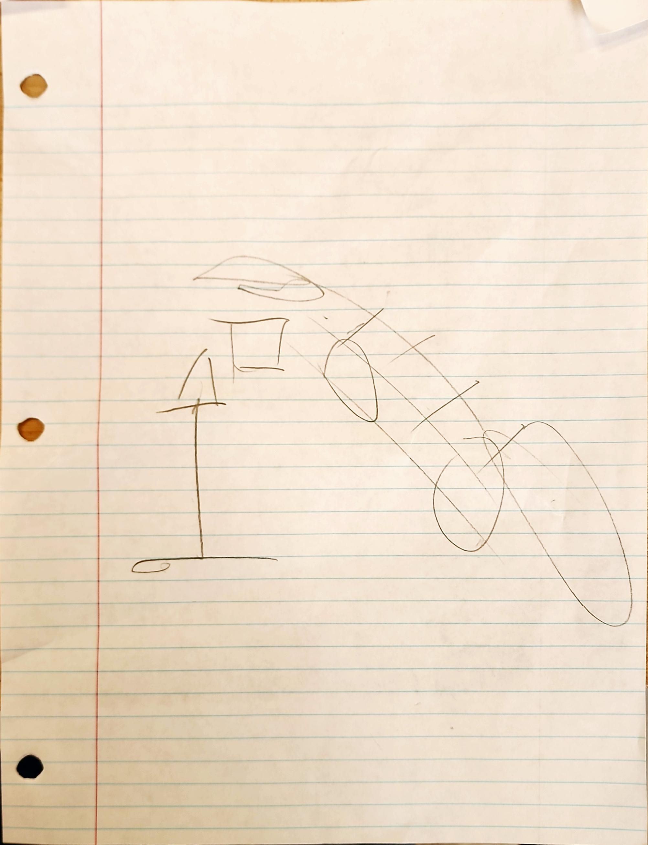
Aurora
Dimas
8/
2

Slide 8
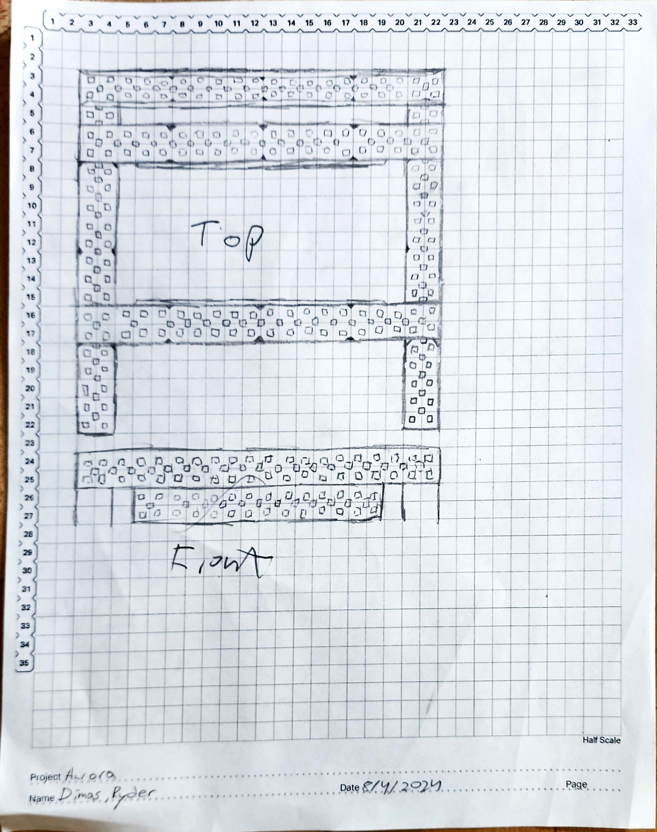
3
Notes:
First Base Drawing

Slide 9
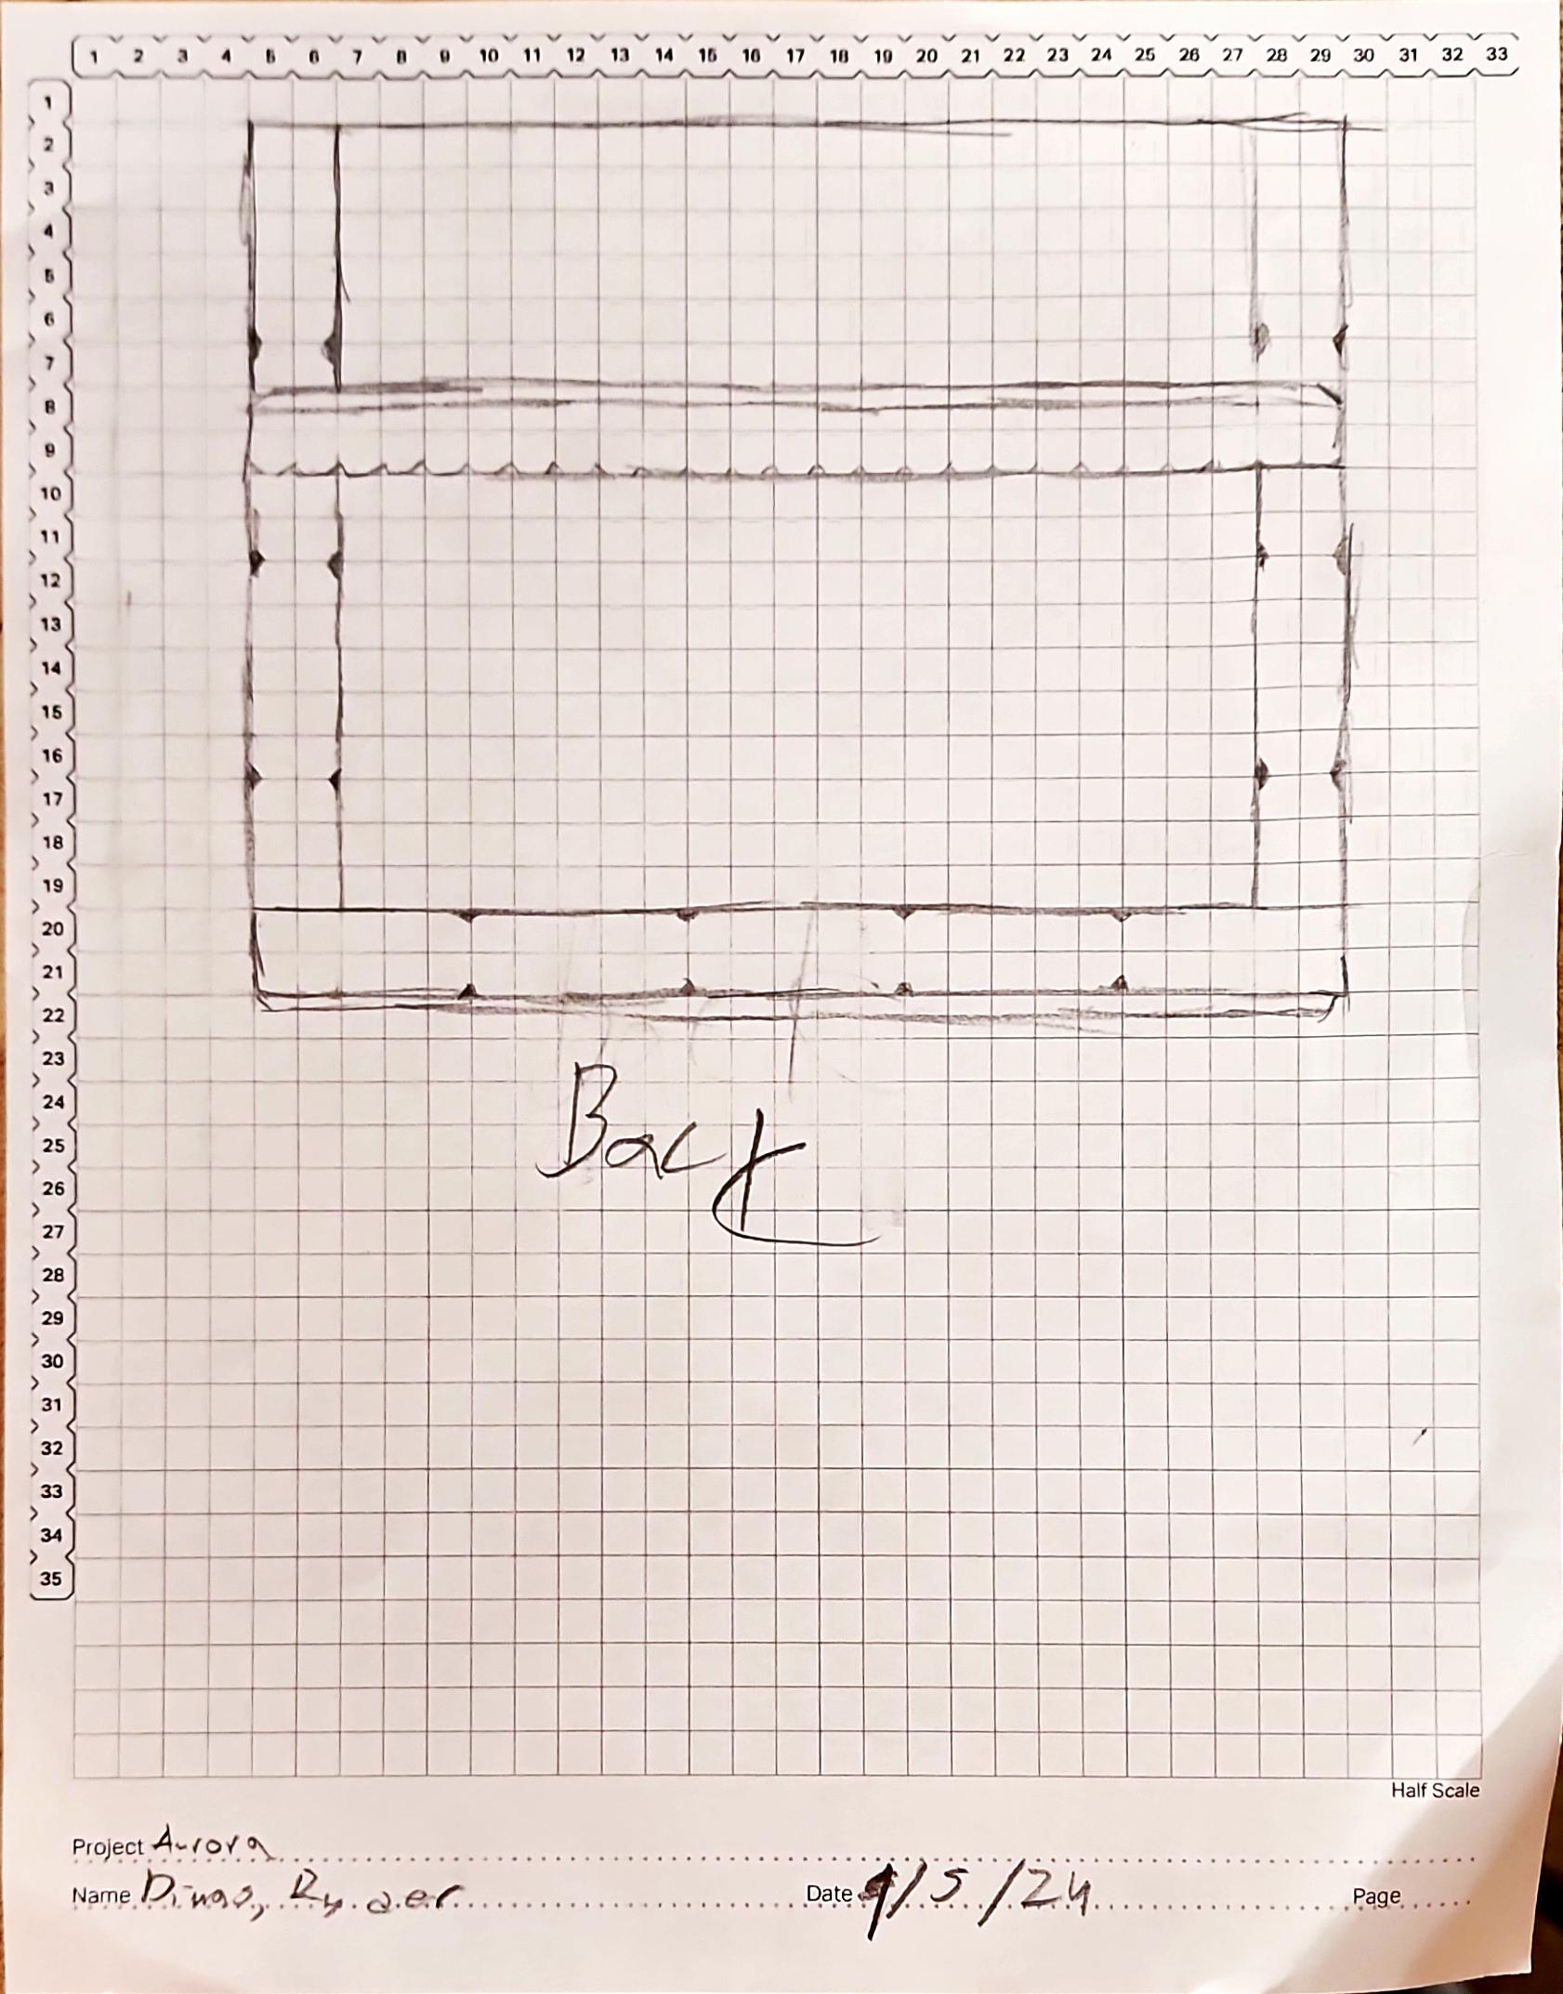
4
Notes:
Second Base Drawing

Slide 10

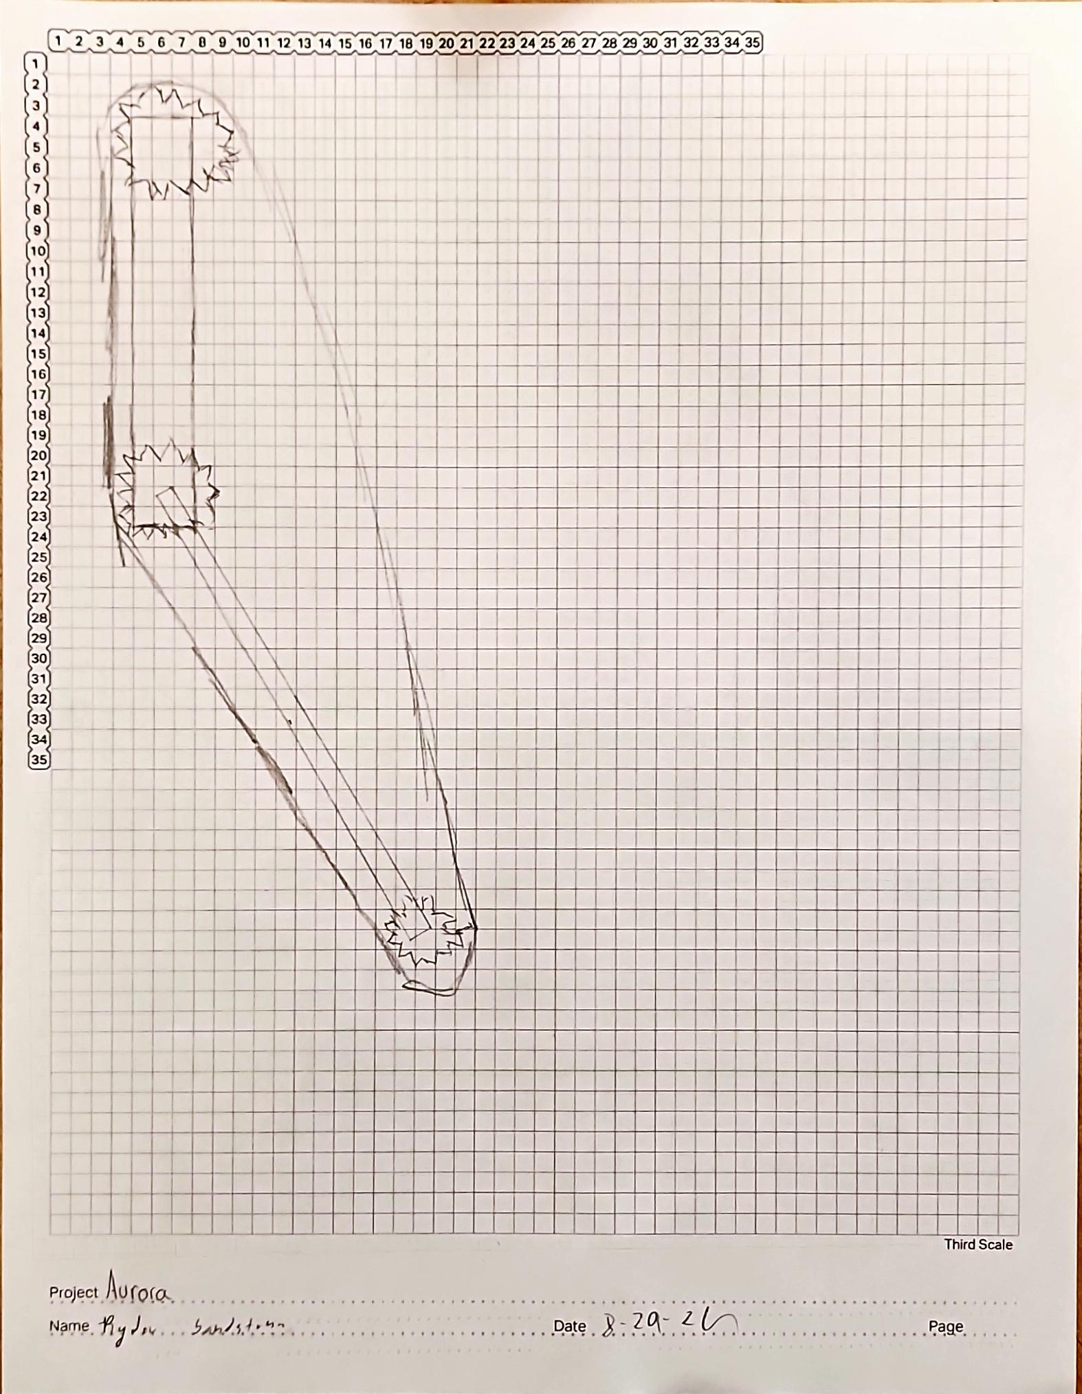

5
Notes:
First Conveyer Belt Drawing

Slide 11
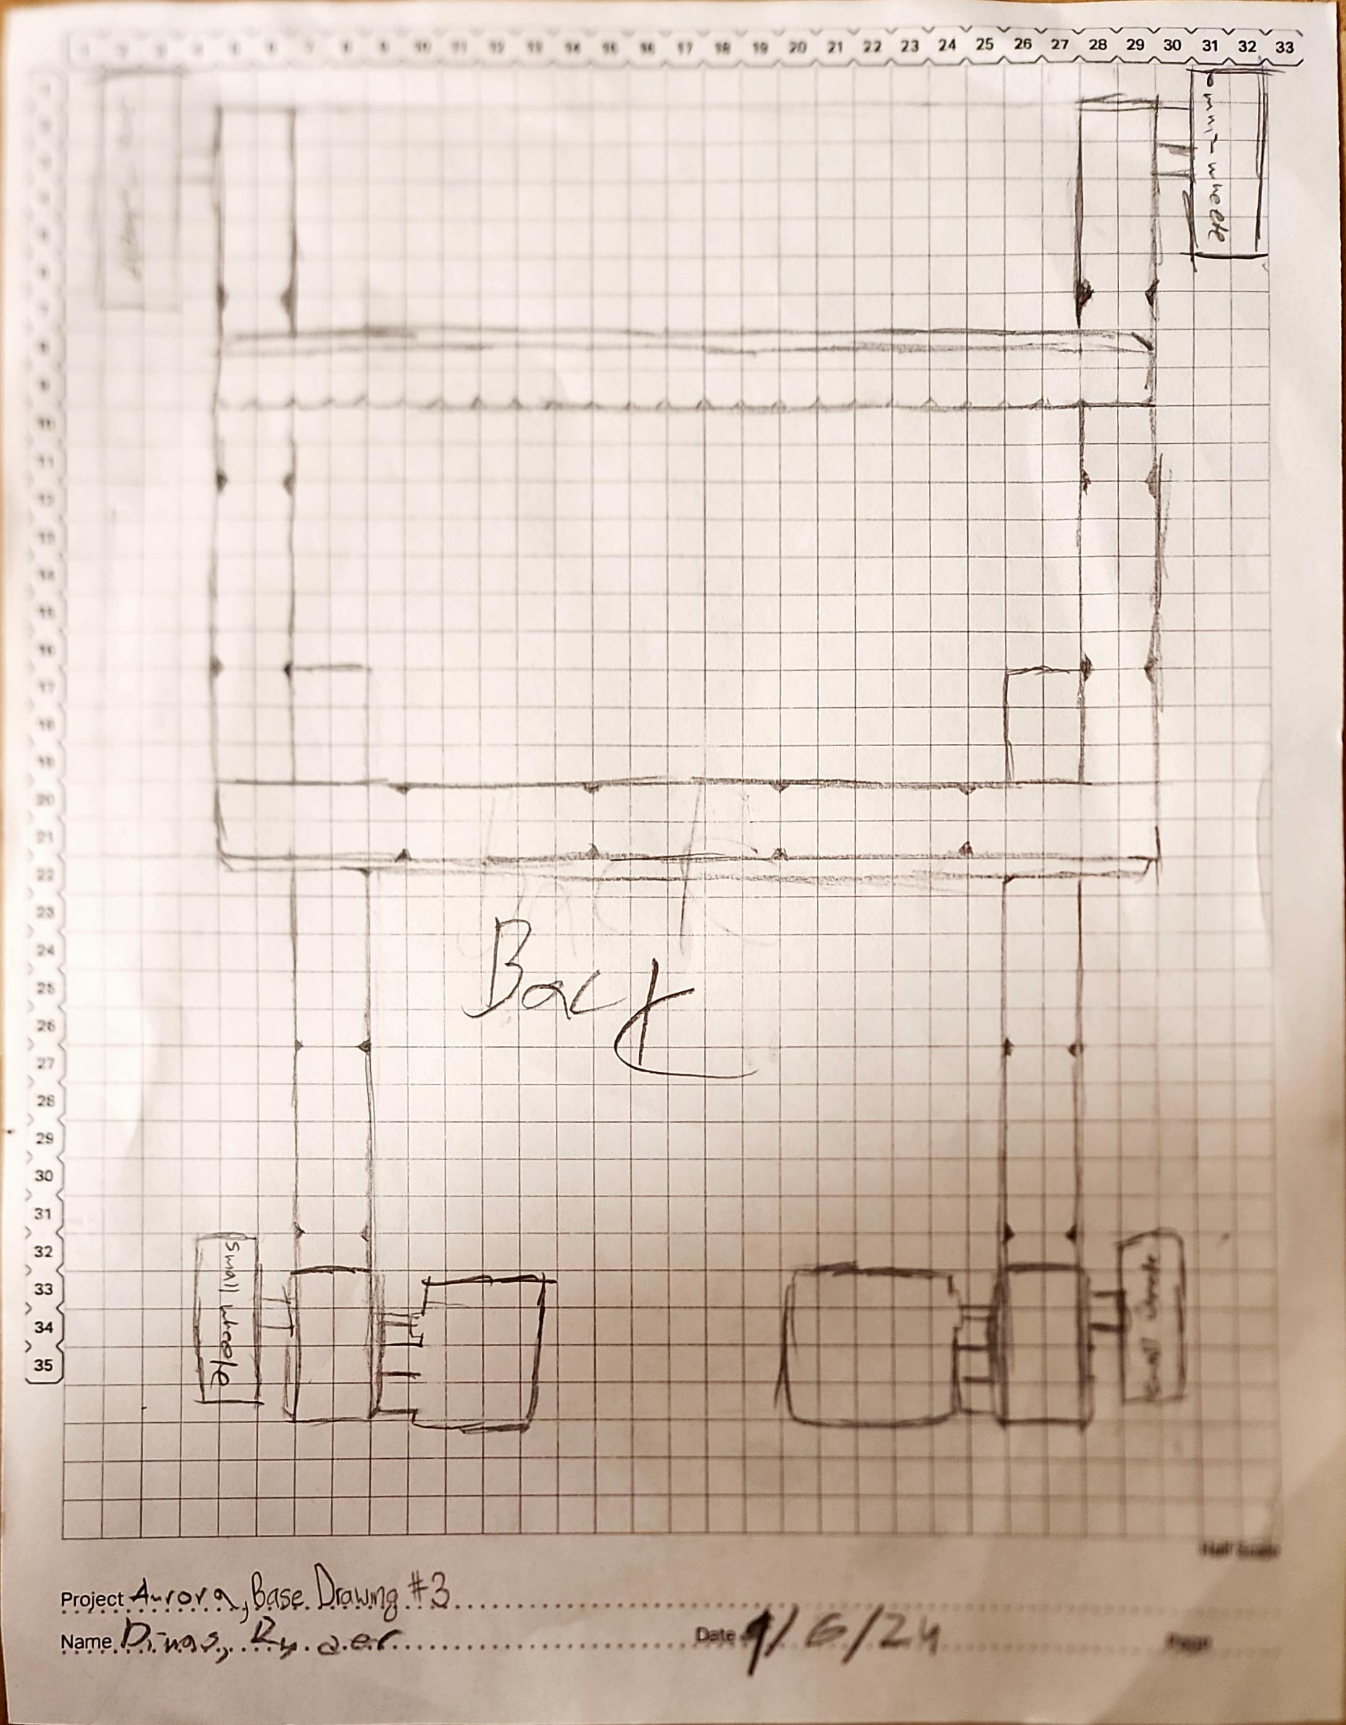
6

Slide 12
Brain Ports/ Controller Program and Game Map

Slide 13
PORT
Right motorT
Radio
Left motor
PORT
PORT
PORT
PORT
PORT
PORT
PORT
PORT
PORT
PORT
PORT
PORT
PORT
Claw motor
Arm motor
PORT
Inertial
PORT
PORT
PORT
PORT
PORT
PORT
PORT
PORT

Slide 14
Arm up
Claw down
Arm down
Claw up
Robot forward
STICK
Robot turn
STICK
BUTTON
Half speed
BUTTON
BUTTON
BUTTON
BUTTON
BUTTON
BUTTON

Slide 15
Blank High Stakes Field

Slide 16


“High Stakes” Starting Field with Moveable Game Objects

Slide 17
“High Stakes” Starting Field with Frozen Game Objects

Slide 18
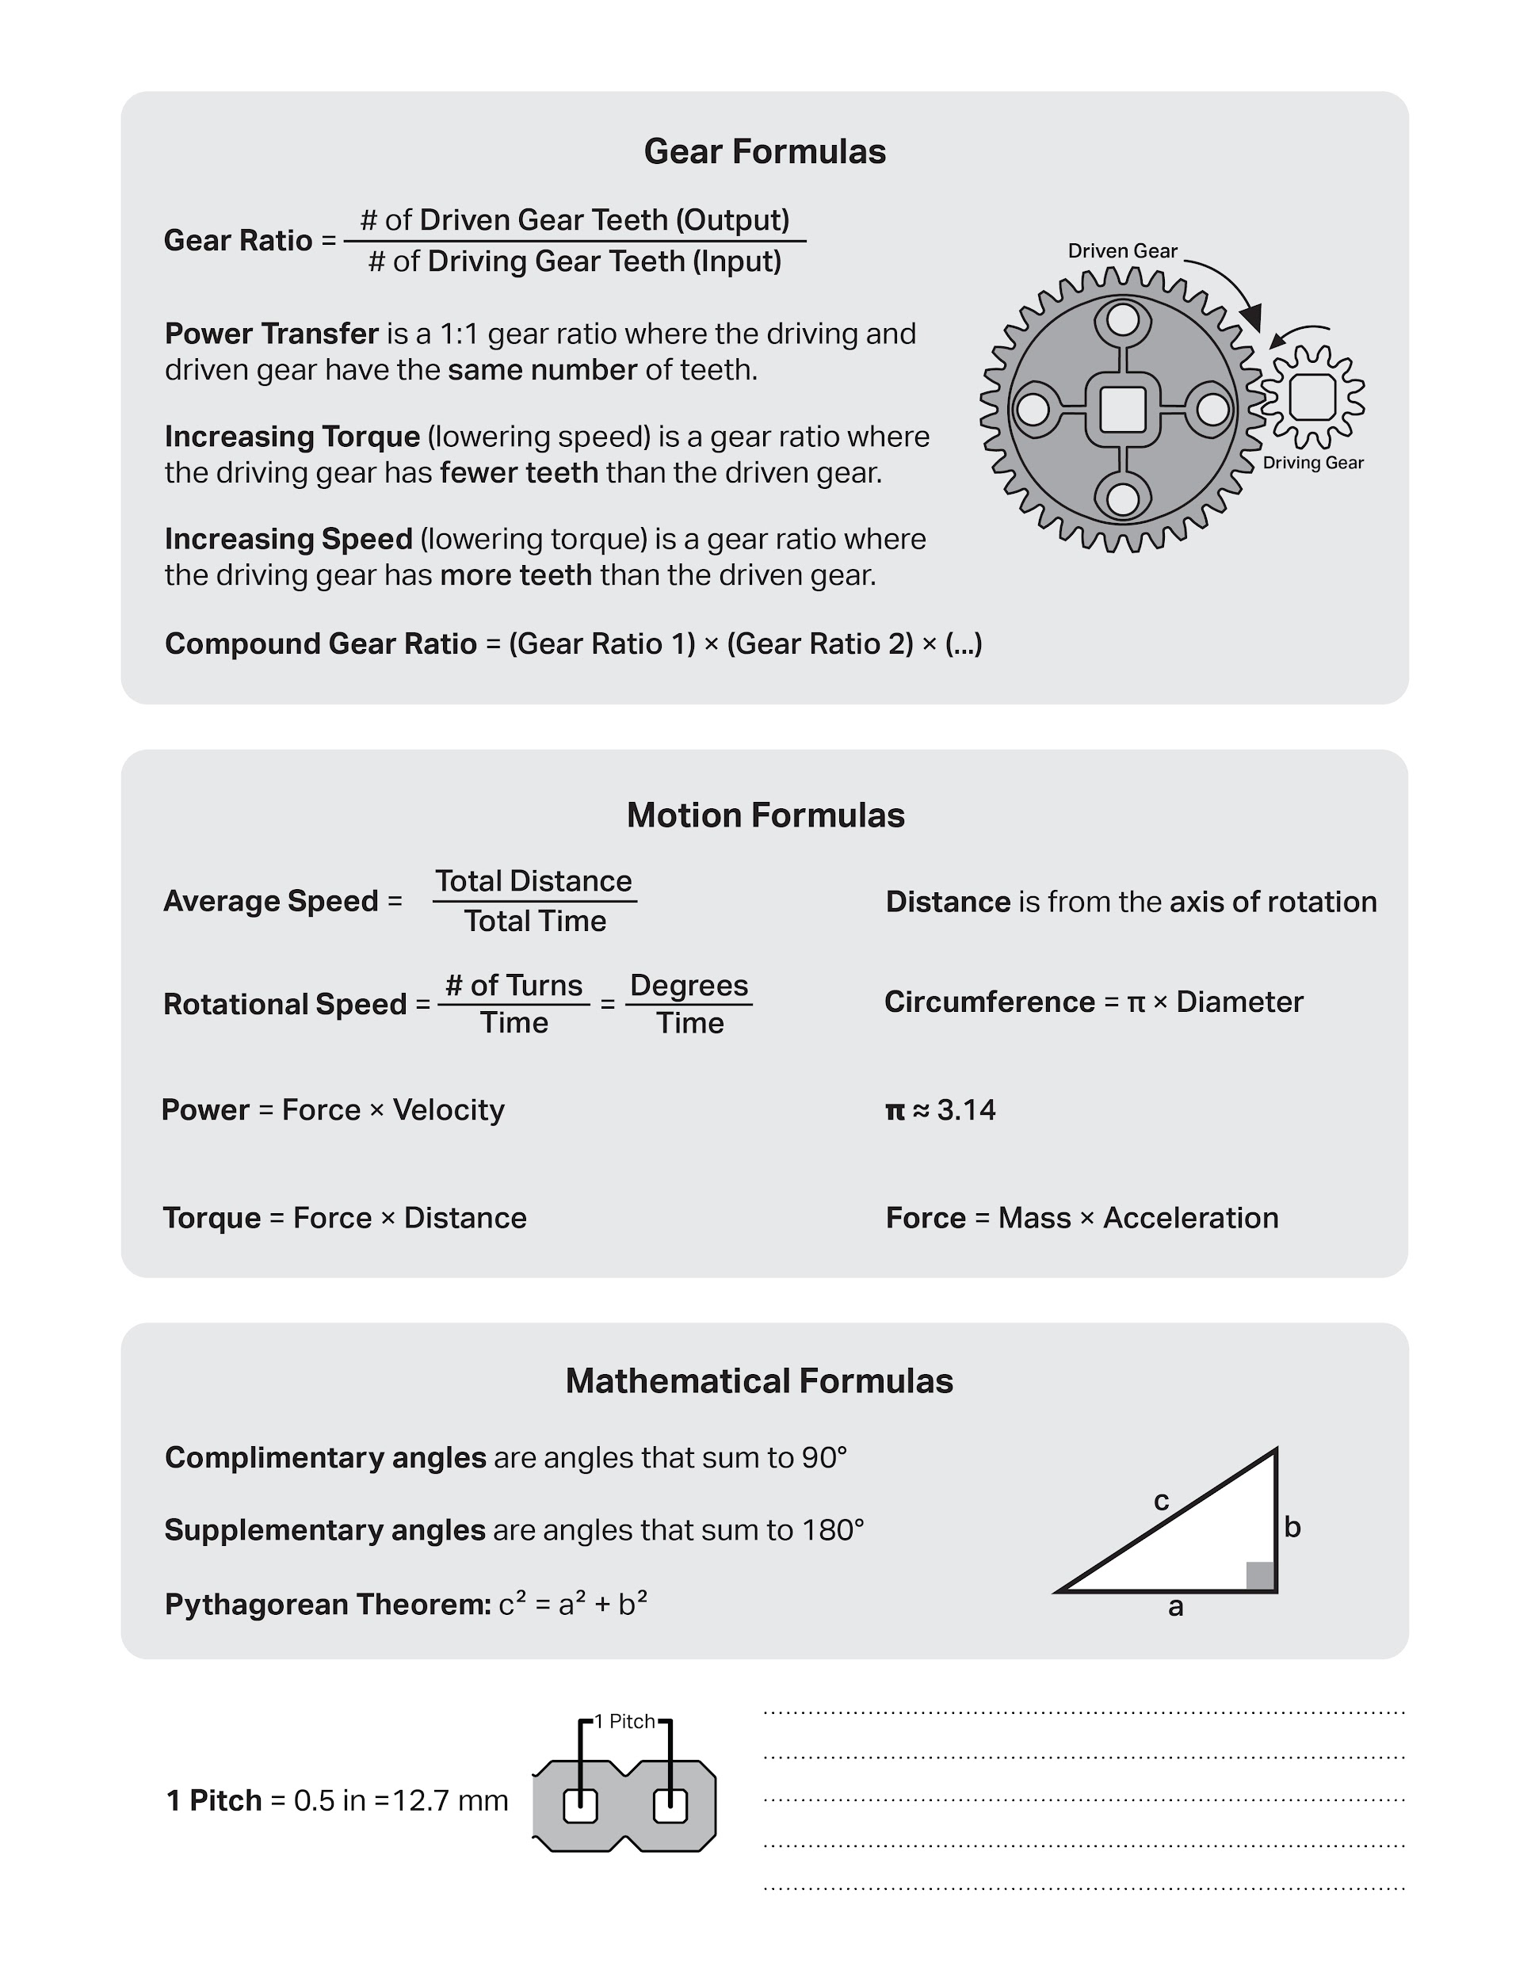

Slide 19
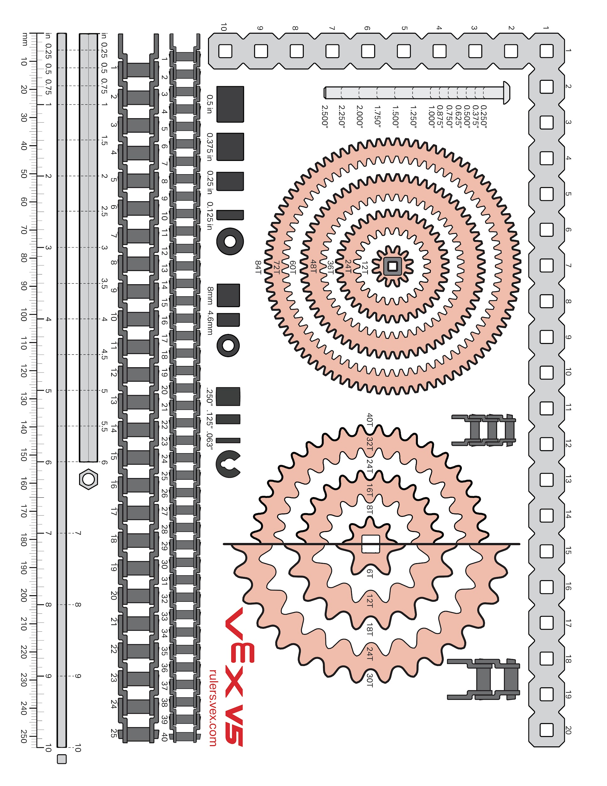

Slide 20
Scrum Notes/ Calenders

Slide 21
Product Backlog
Product Backlog for Competition Bot:
Review and Understand the Rules
Identify any limiting rules
Make sure design within the size limit.
2. Design the robot
a. Generate ideas
b. Draw out ideas
c. Test ideas
2. Build the Robot
a. Build Conveyer Belt
b. Build Base
3. Code the Robot
a. Code for the main bot
b. Code for attachment
c. Code for controller
i. Code for secondary controller
d. Code for sensors
4. Test the Robot
5. Practice the Challenge
6. Evaluate our challenge results
Abigail Way
8/28/2024
14

Slide 22
Sprint Backlog
Sprint Backlog For Sprint #1
Building:
Build Base
Coding
Get familiar with the coding
Abigail Way
8/28/2024
15

Slide 23
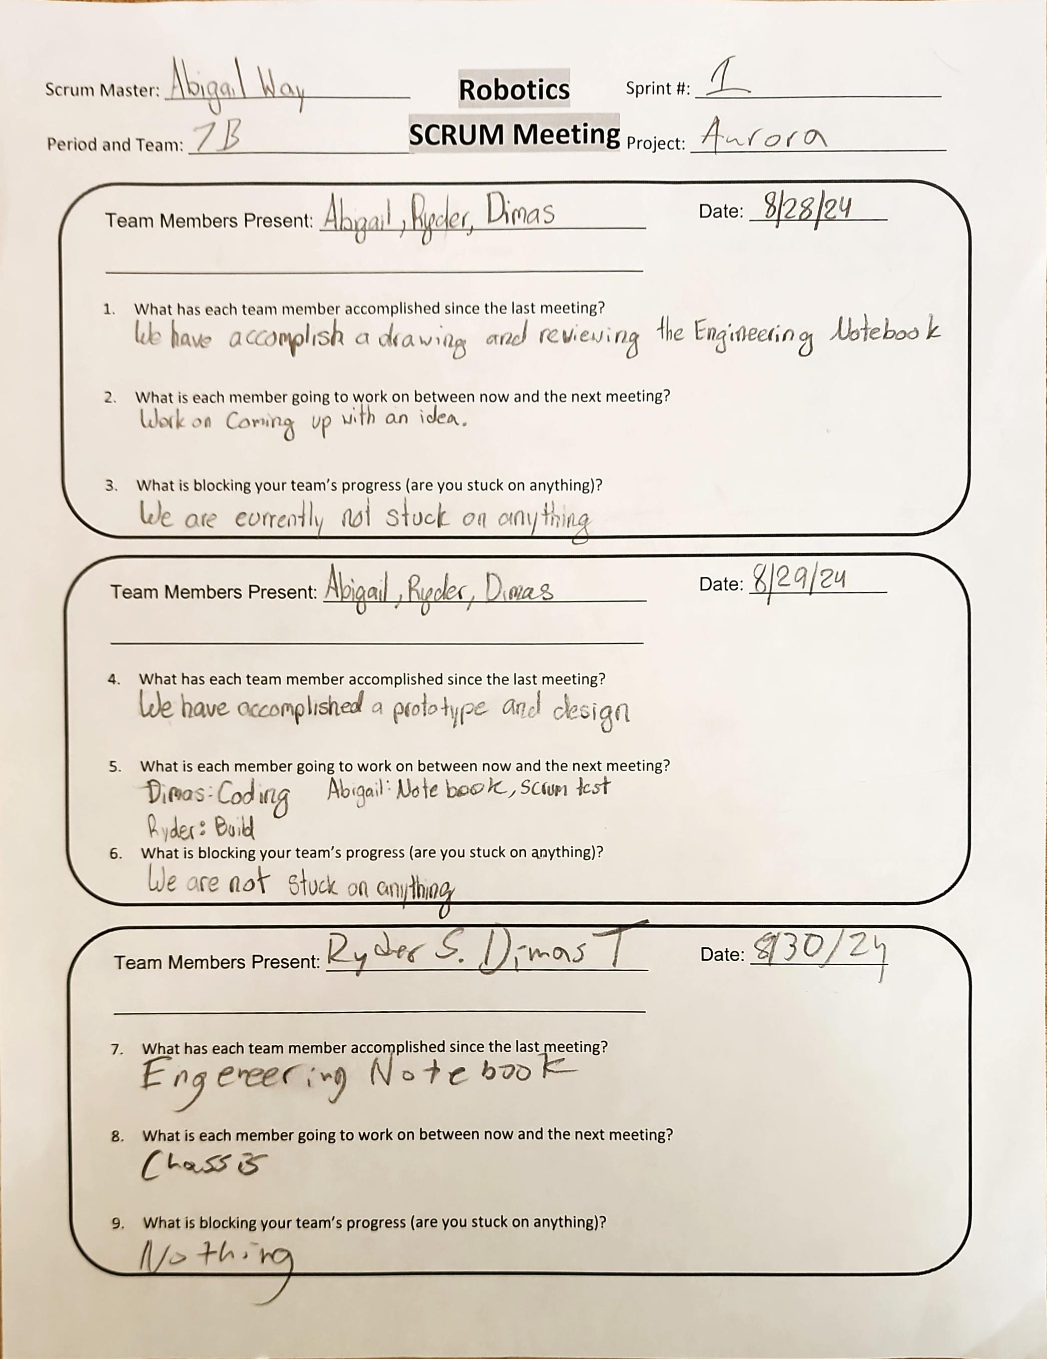
Project: Scrum Meeting
Name: Abigail Way Date:9/11/24 Page: 16

Slide 24
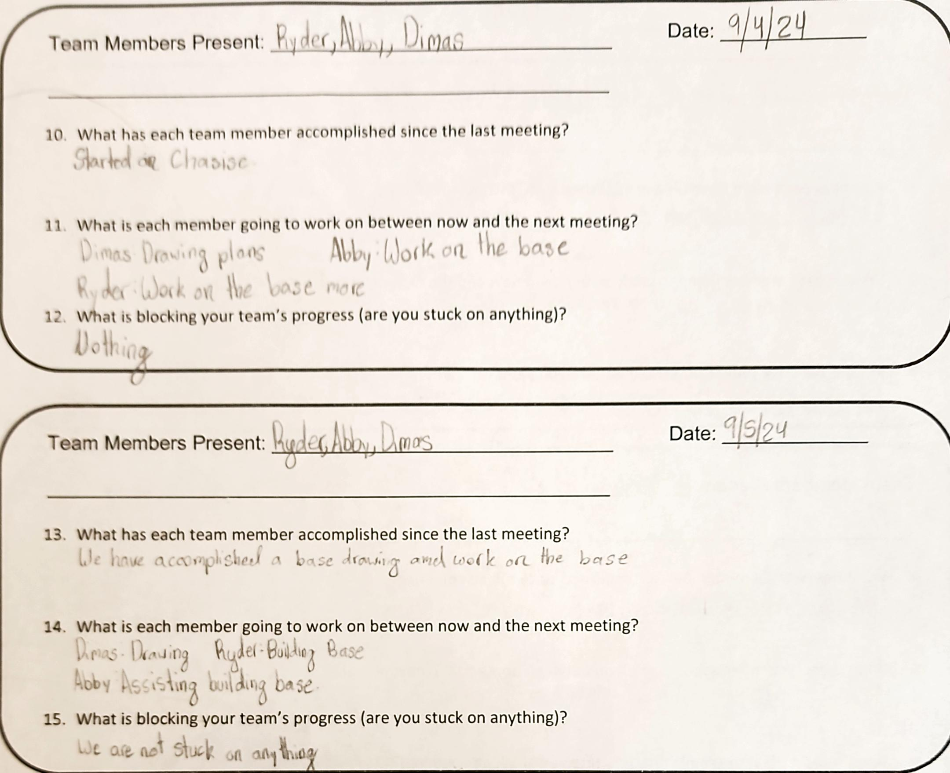
Project: Scrum Meeting
Name: Abigail Way Date:9/11/24 Page: 17

Slide 25
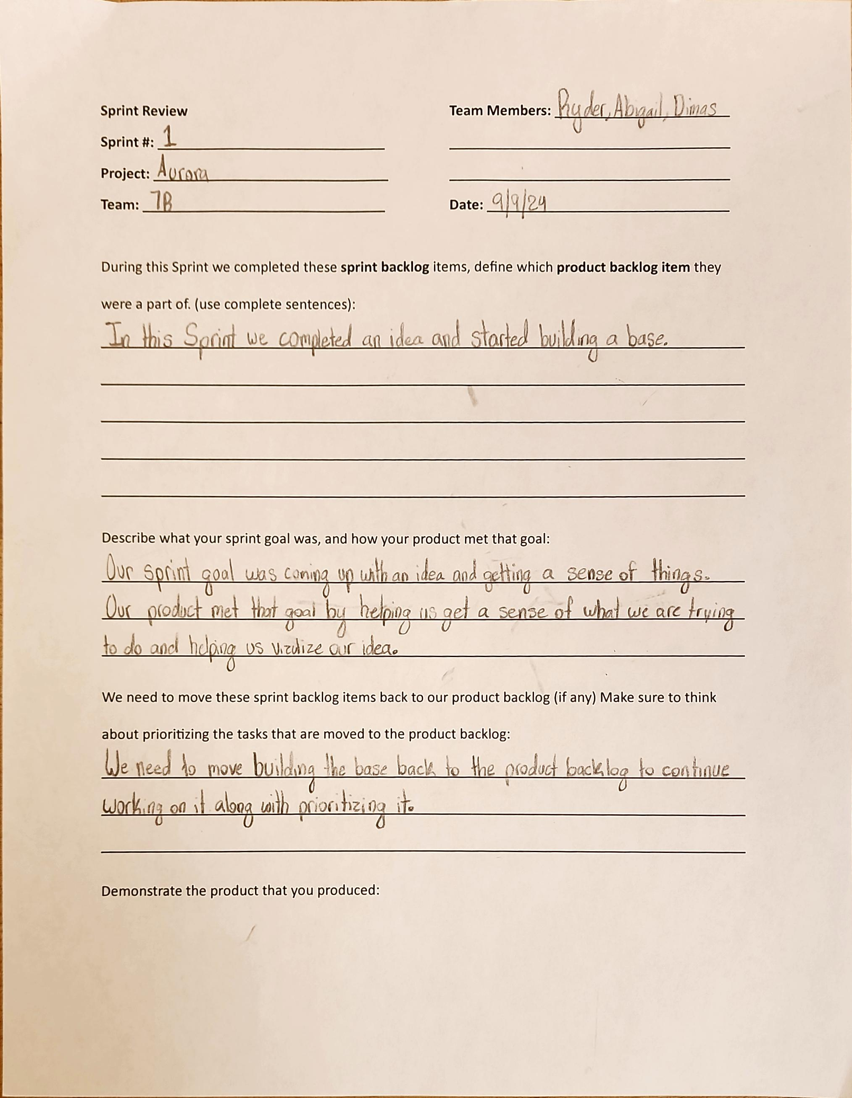
Project: Sprint Review
Name: Abigail Way Date:9/11/24 Page: 18

Slide 26
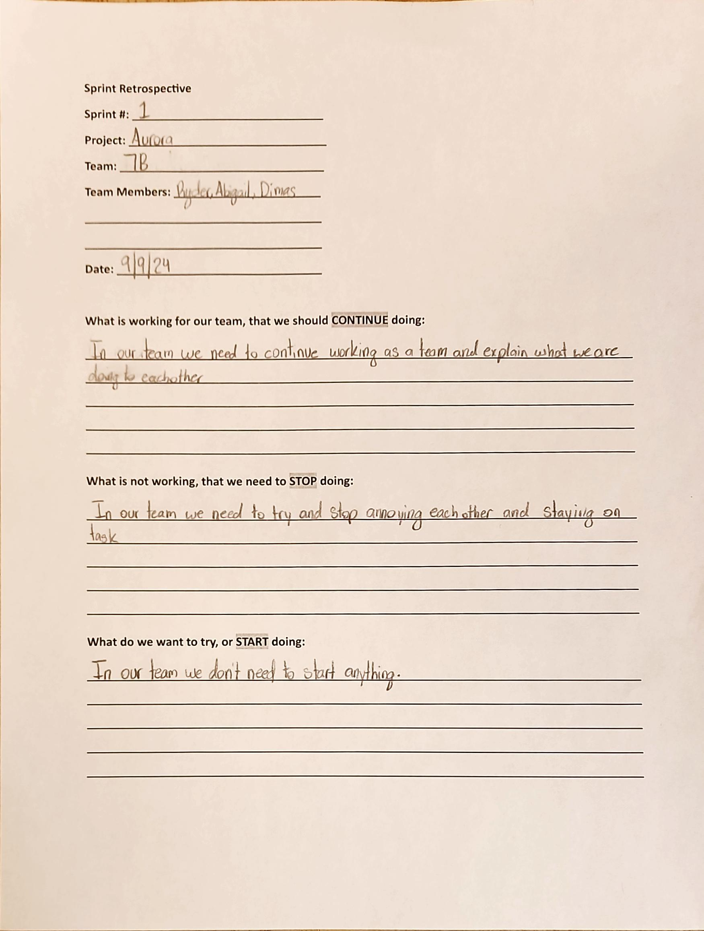
Project: Sprint Retrospective
Name: Abigail Way Date:9/11/24 Page: 19

Slide 27
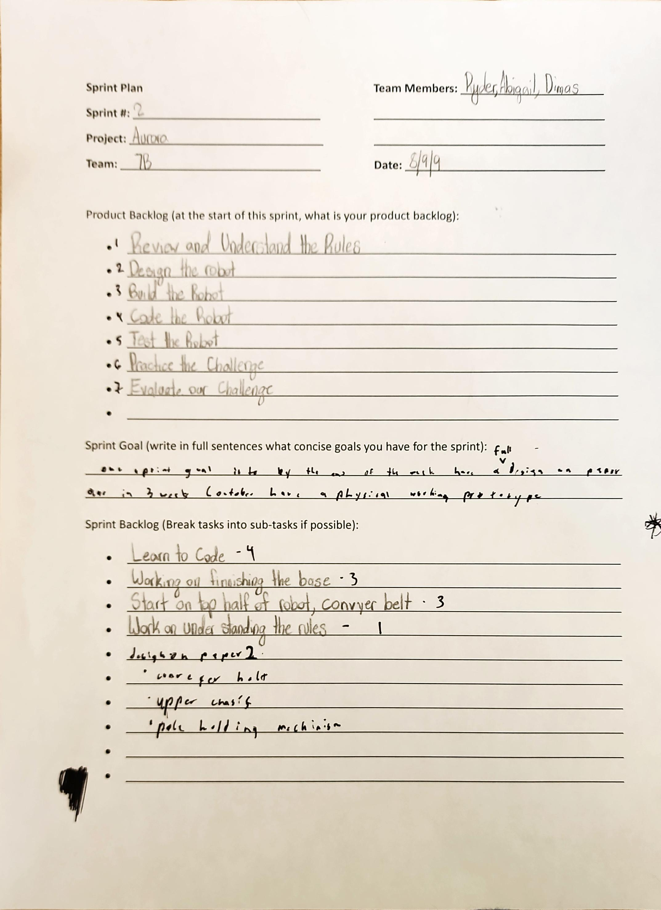
Project: Sprint Plan
Name: Abigail Way Date:9/11/24 Page: 20

Slide 28
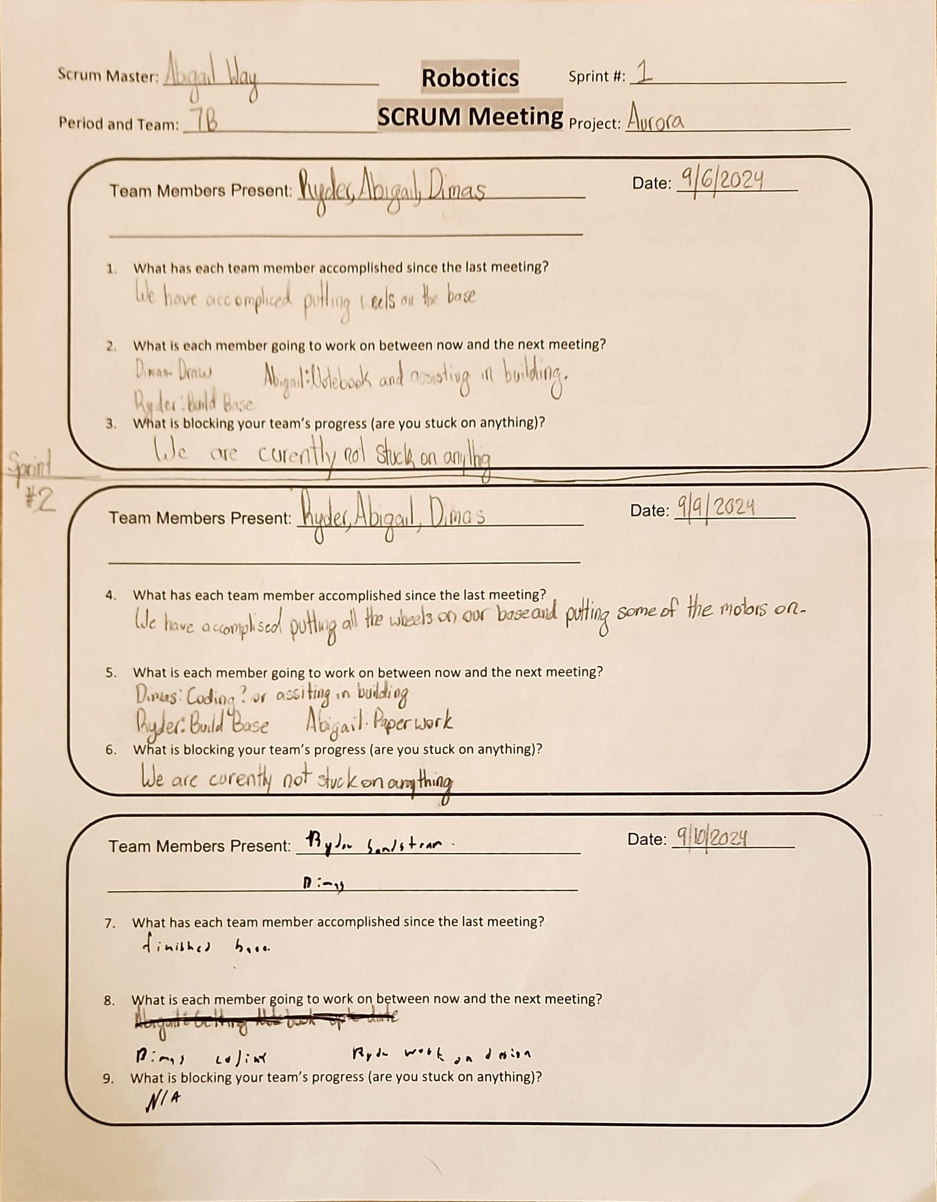
Project: Scrum Meeting
Name: Abigail Way Date:9/11/24 Page: 21

Slide 29
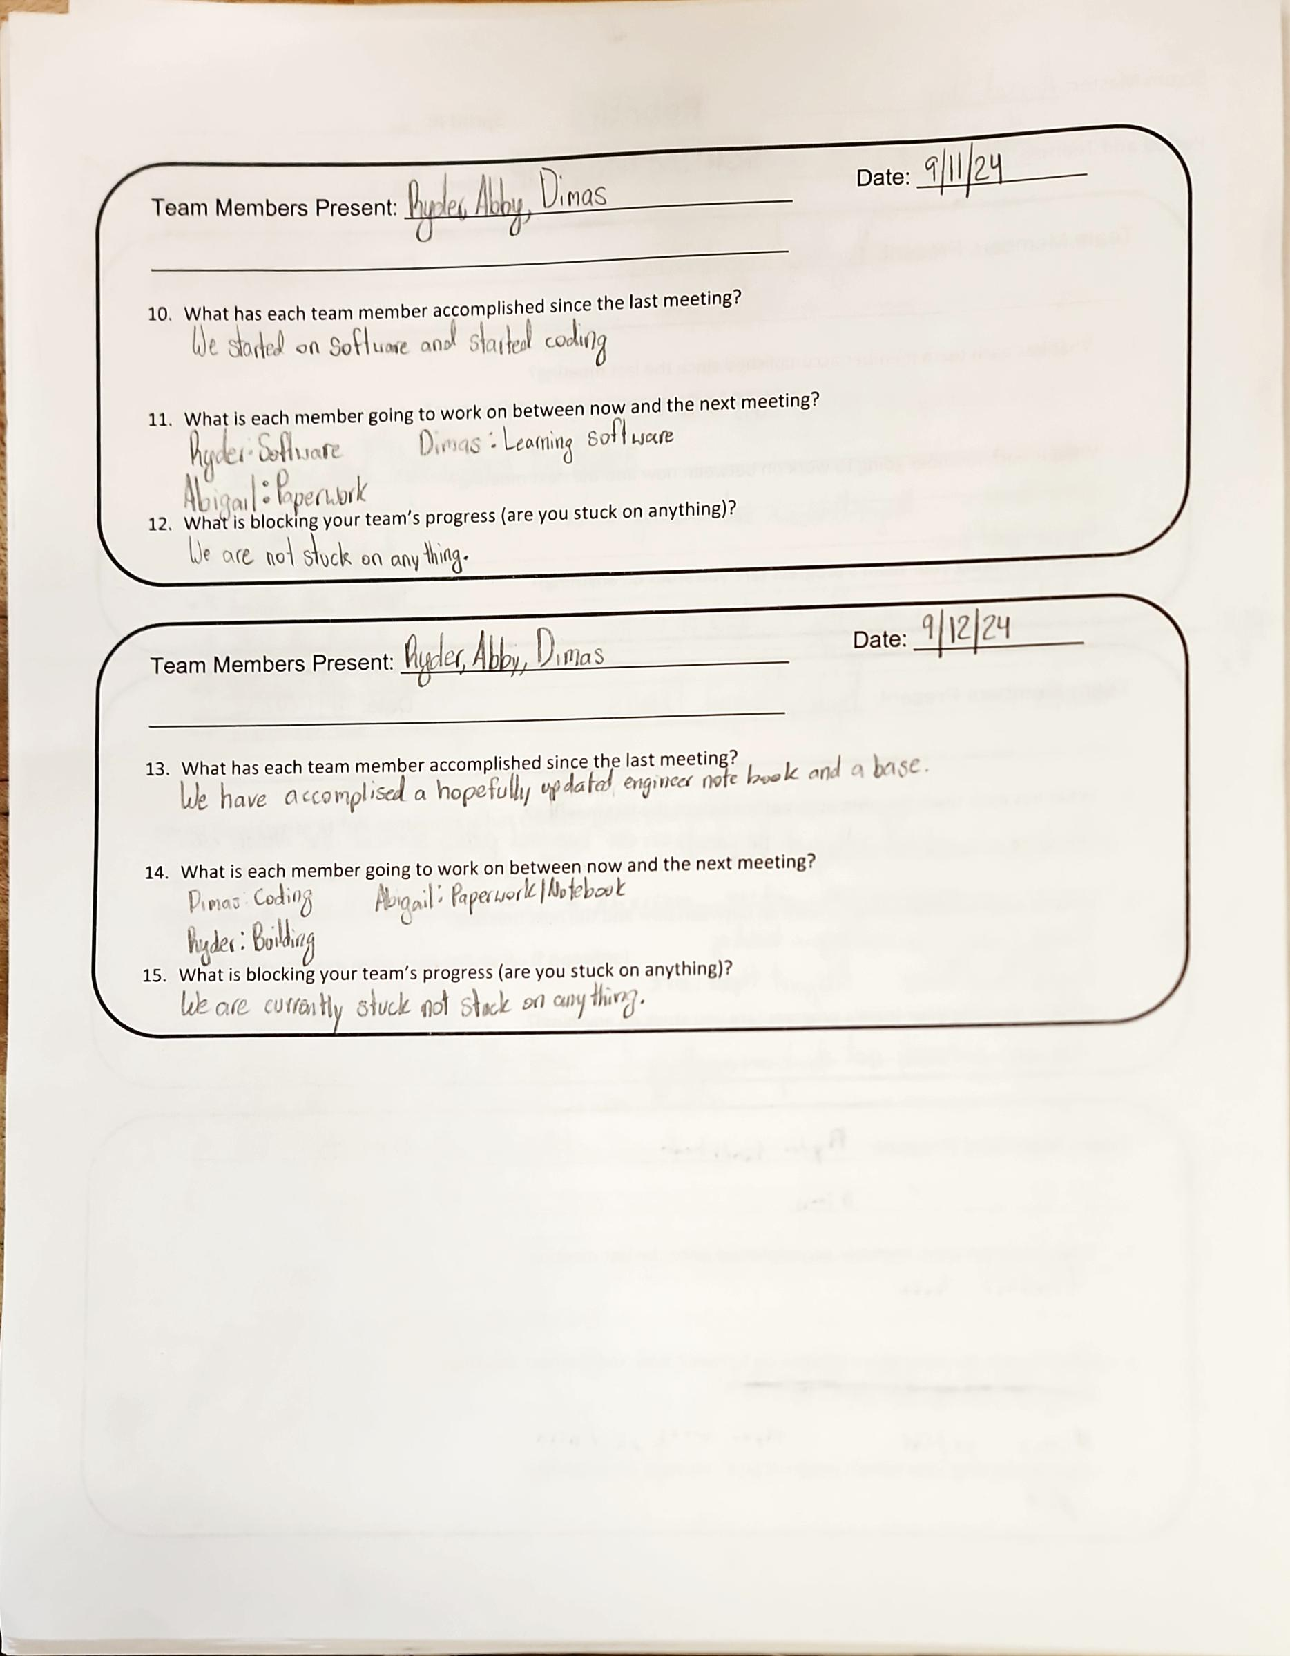
Project: Scrum Meeting
Name: Abigail Way Date:9/11/24 Page: 22

Slide 30
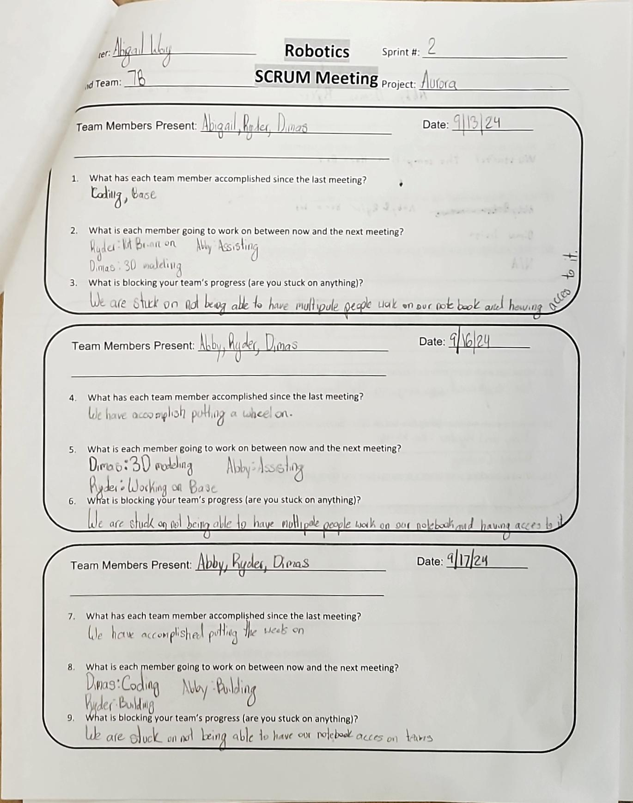
Project: Scrum Meeting
Name: Abigail Way Date:10/21/24 Page: 23

Slide 31
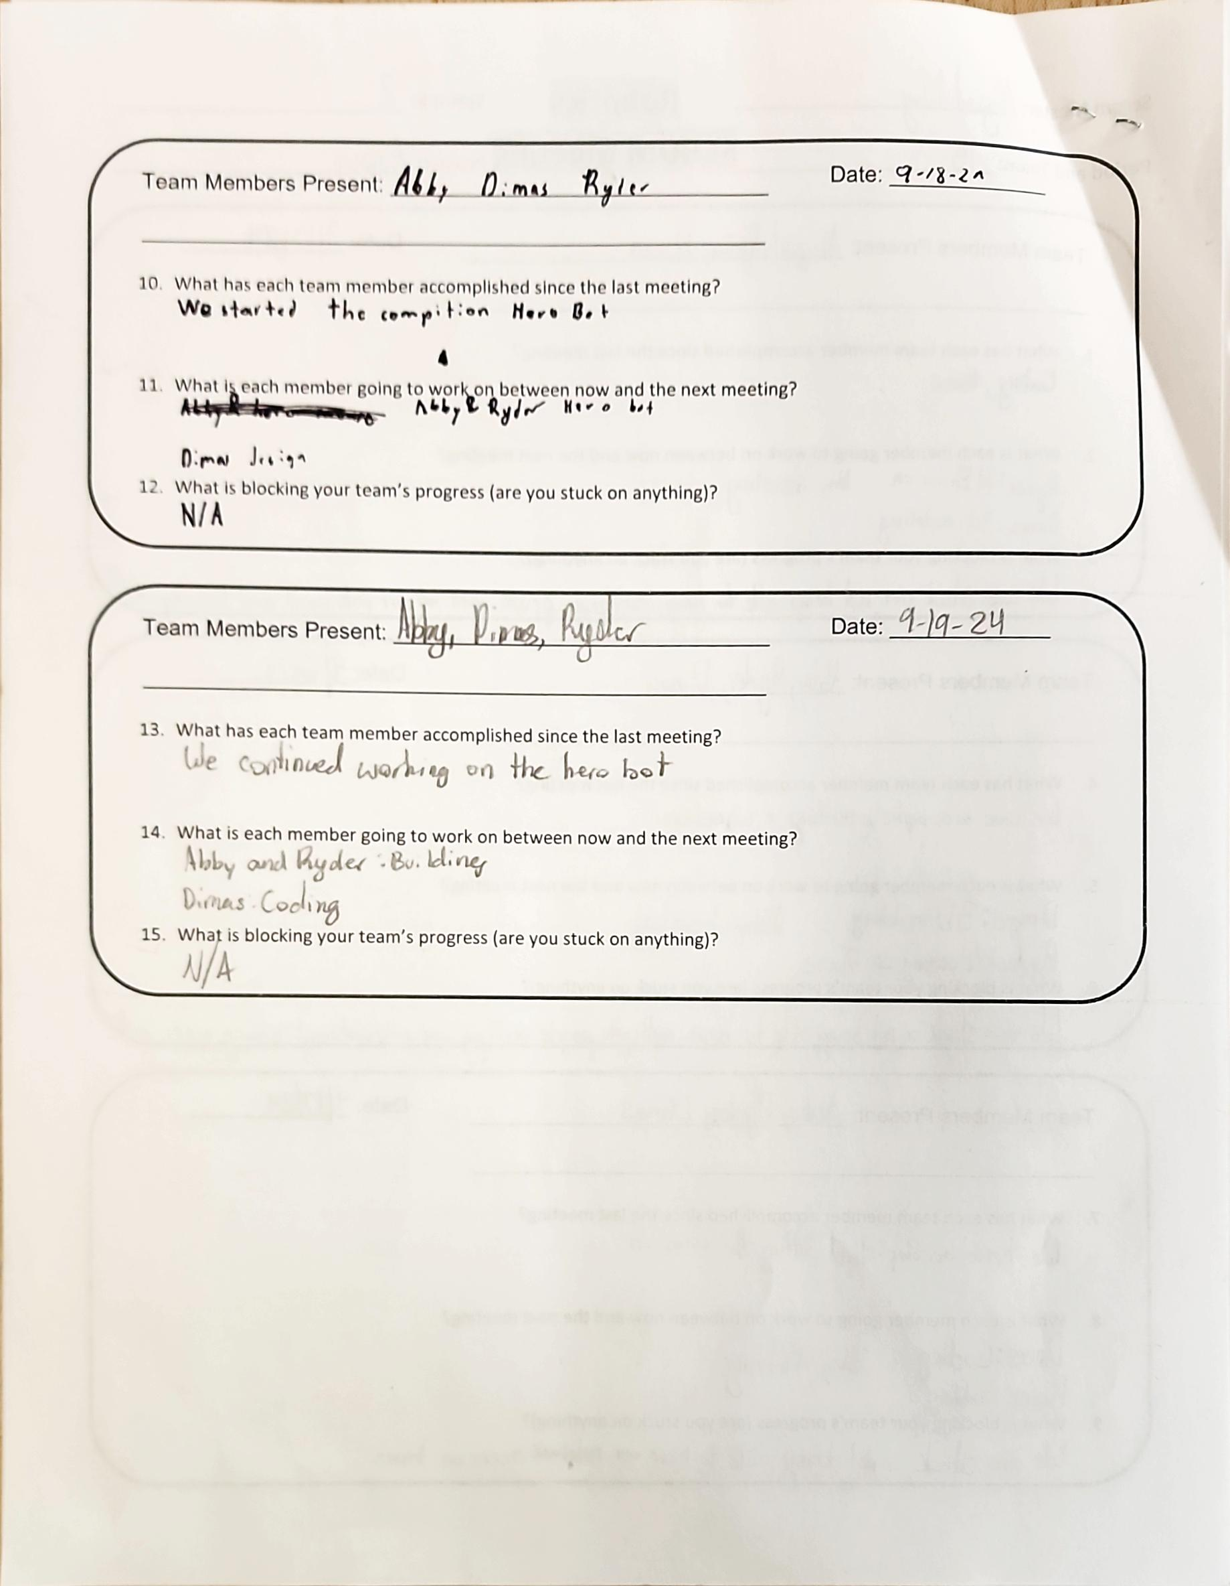
Project: Scrum Meeting
Name: Abigail Way Date:10/21/24 Page: 24

Slide 32
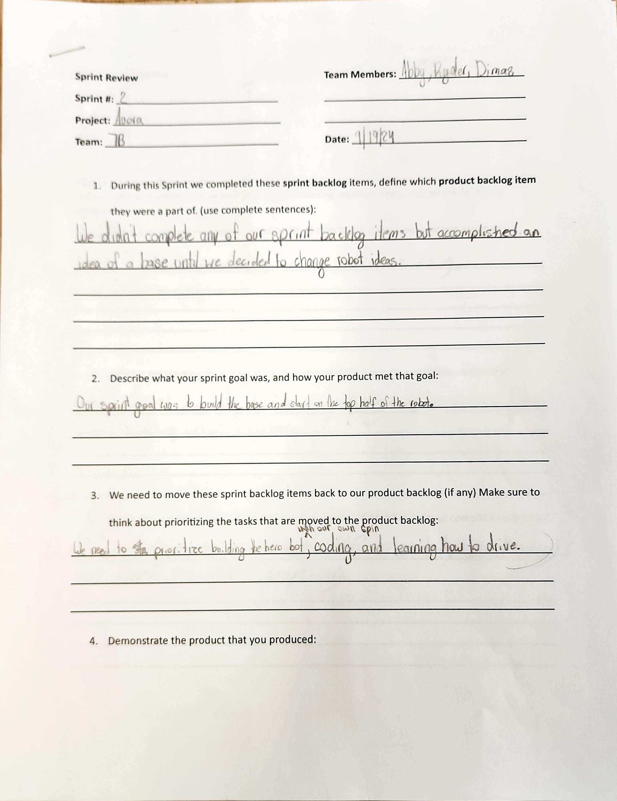
Project: Sprint Review
Name: Abigail Way Date:10/21/24 Page: 25

Slide 33
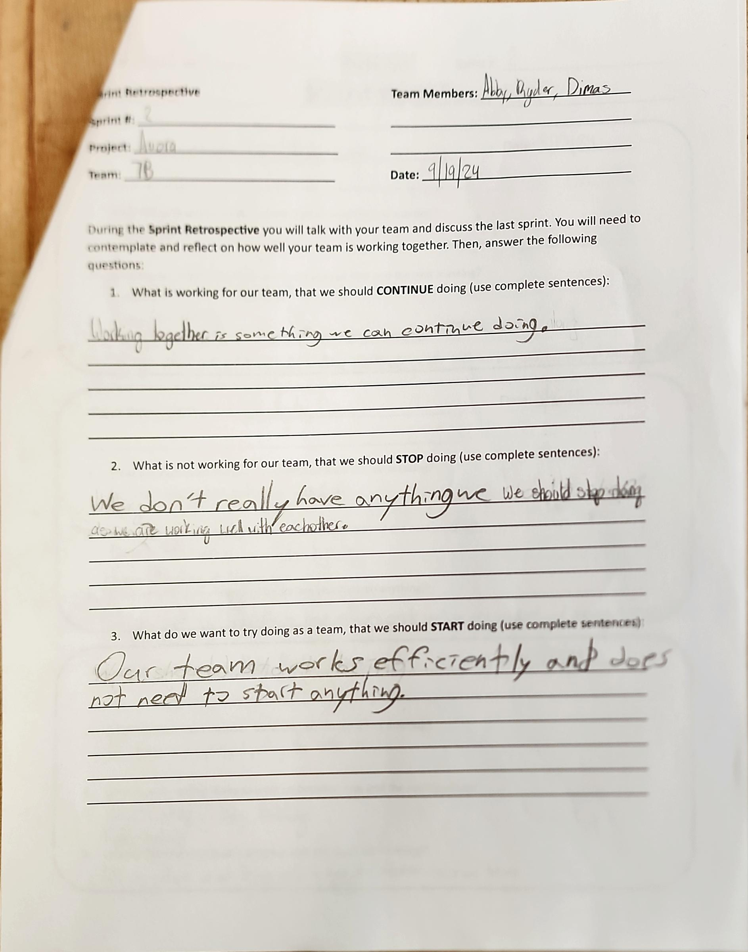
Project: Sprint Retrospective
Name: Abigail Way Date:10/21/24 Page: 26

Slide 34
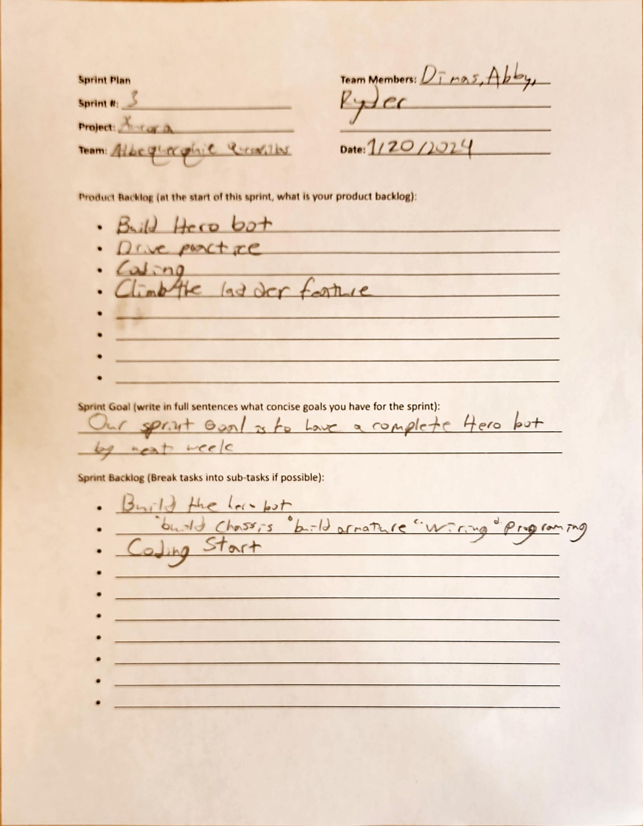
Project: Sprint Plan
Name: Abigail Way Date:10/21/24 Page: 27

Slide 35
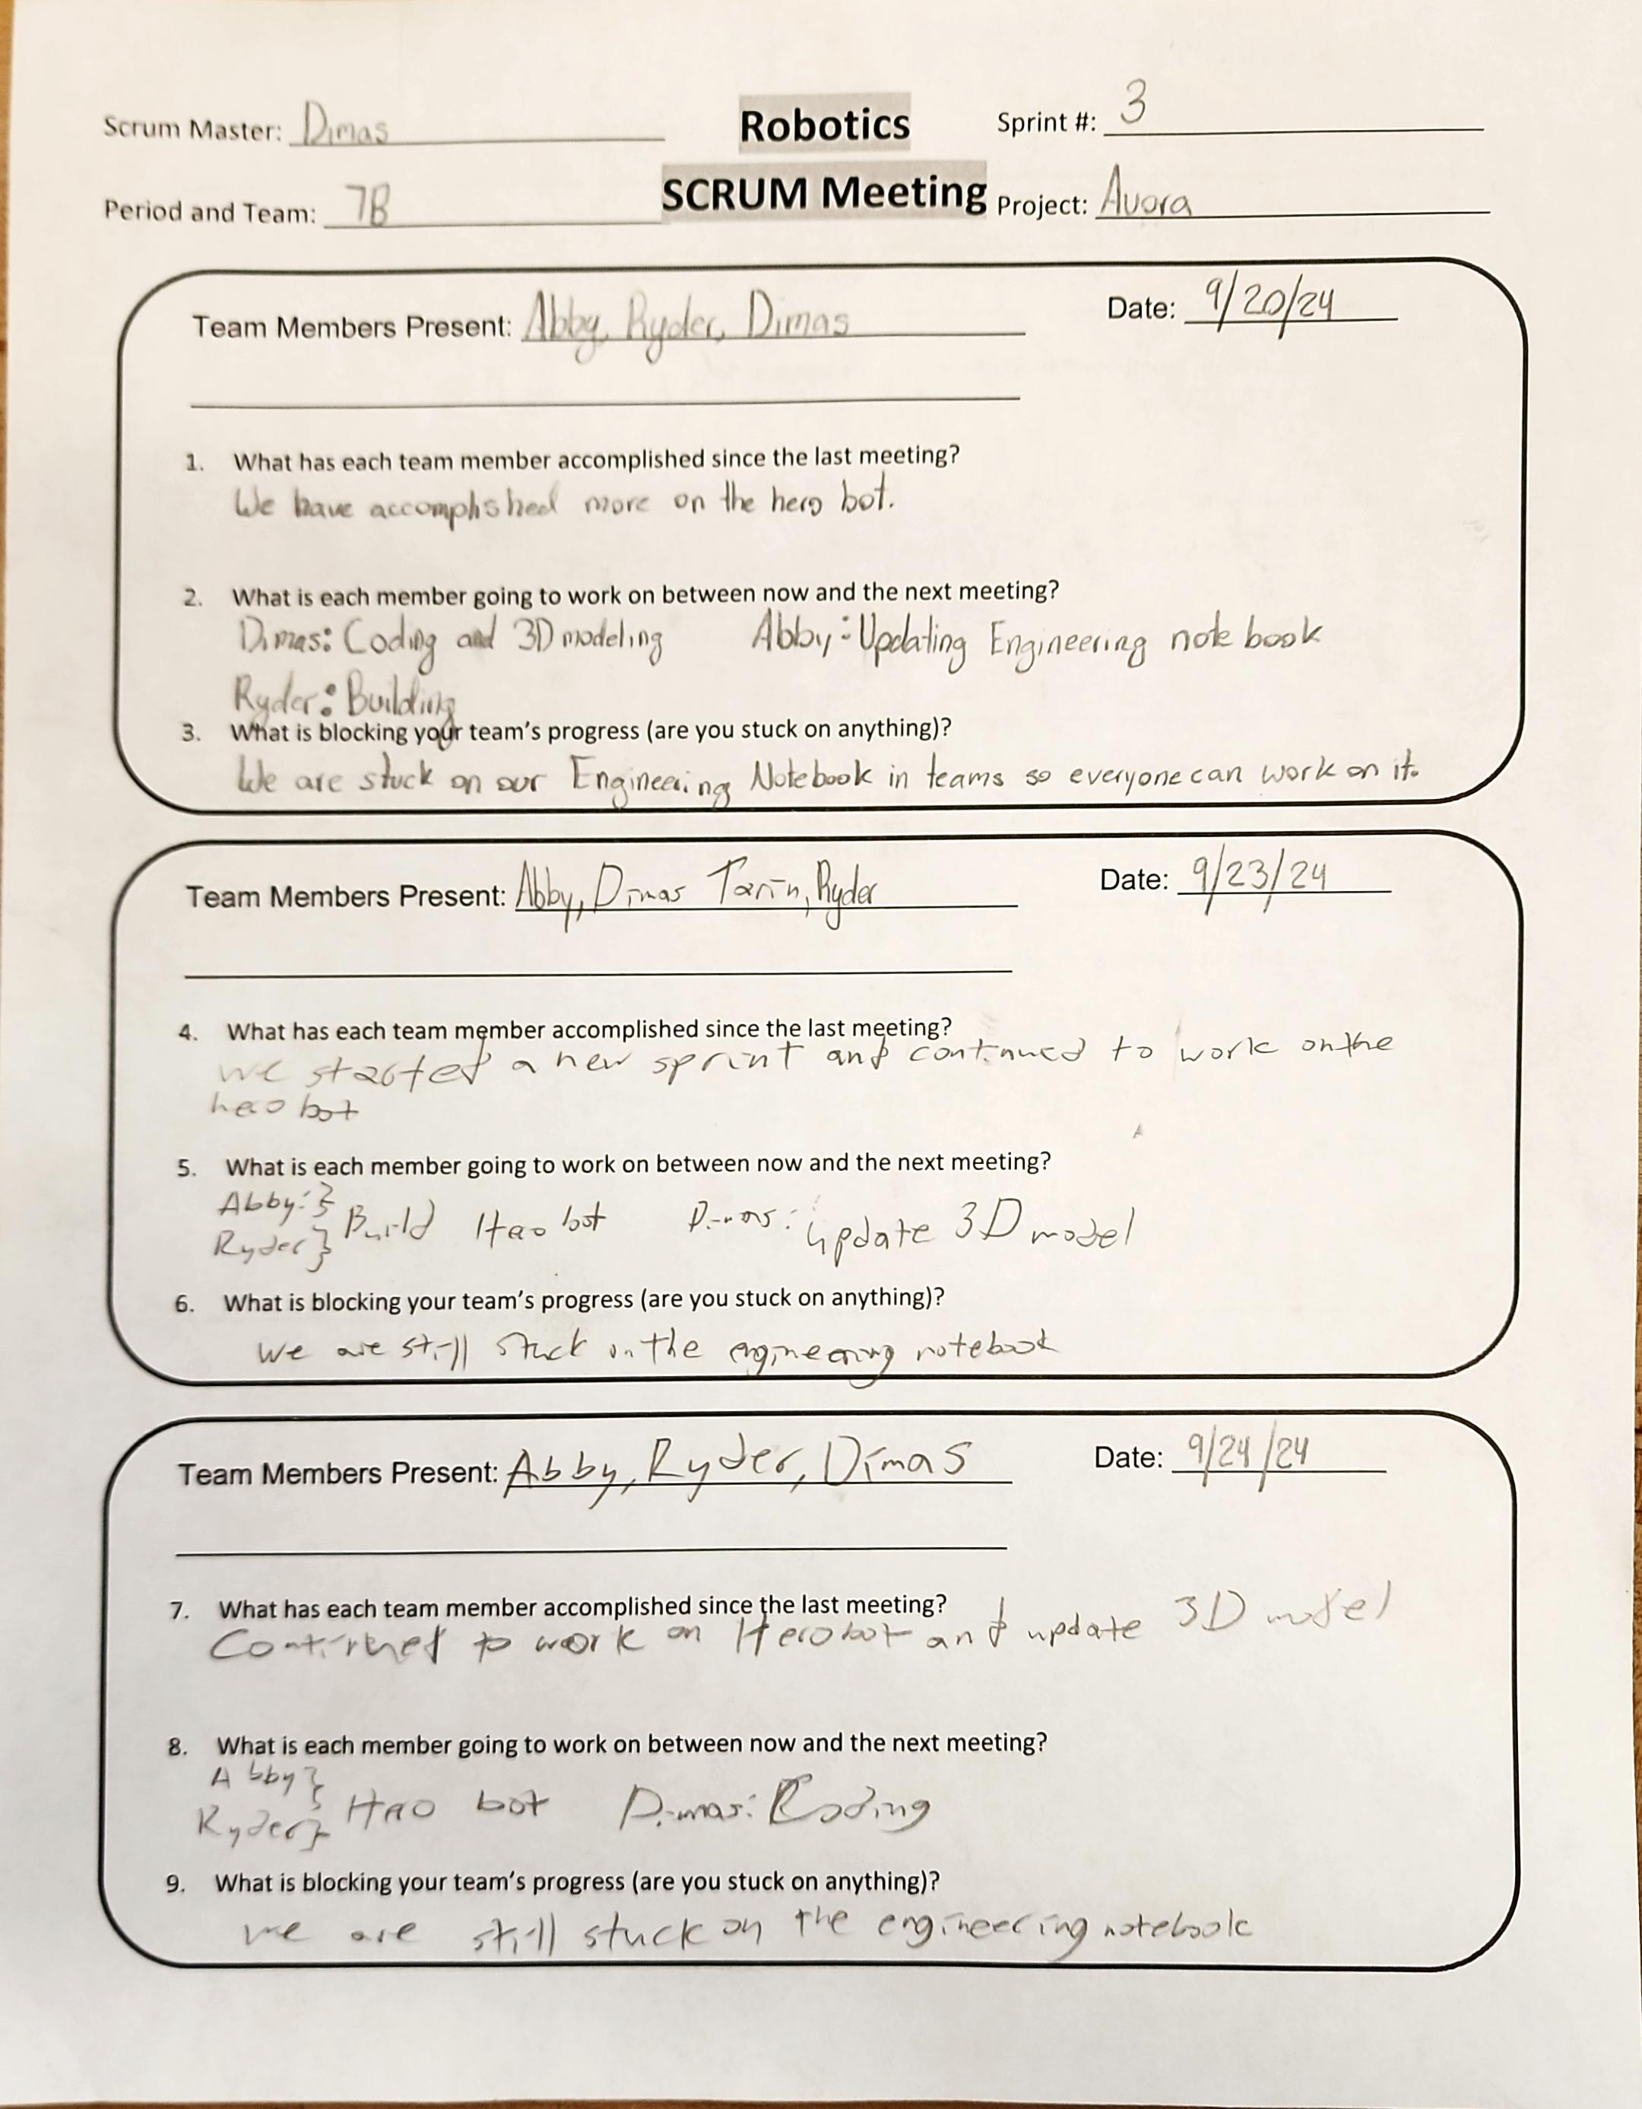
Project: Scrum Meeting
Name: Abigail Way Date:10/21/24 Page: 28

Slide 36
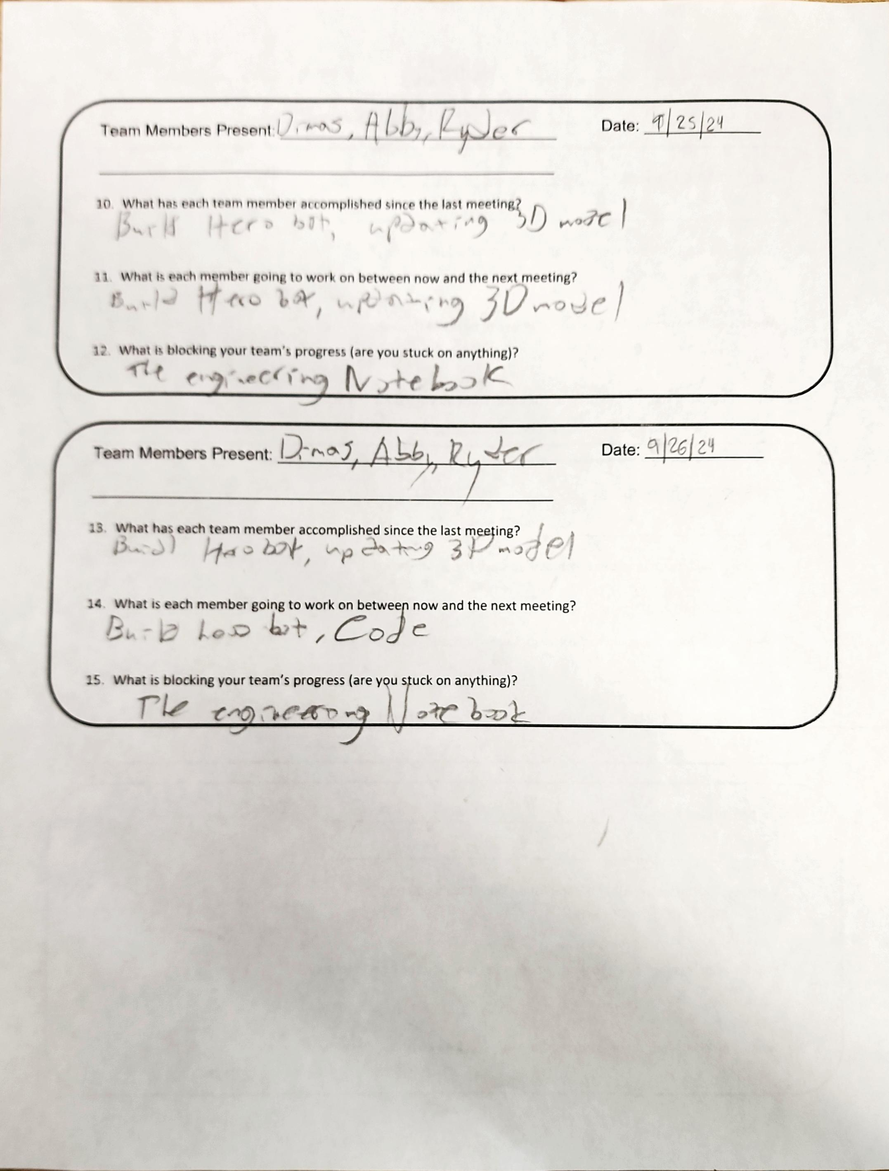
Project: Scrum Meeting
Name: Abigail Way Date:10/21/24 Page: 29

Slide 37
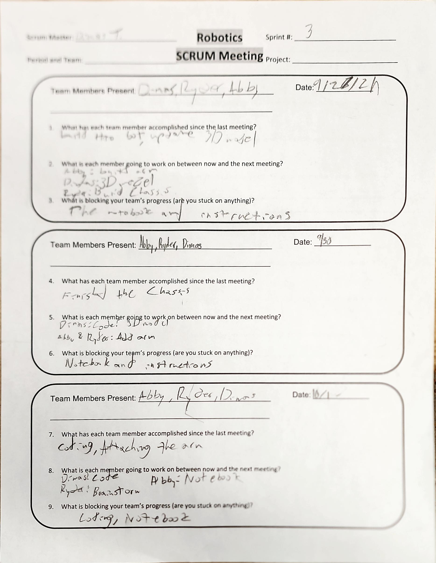
Project: Scrum Meeting
Name: Abigail Way Date:10/21/24 Page: 30

Slide 38
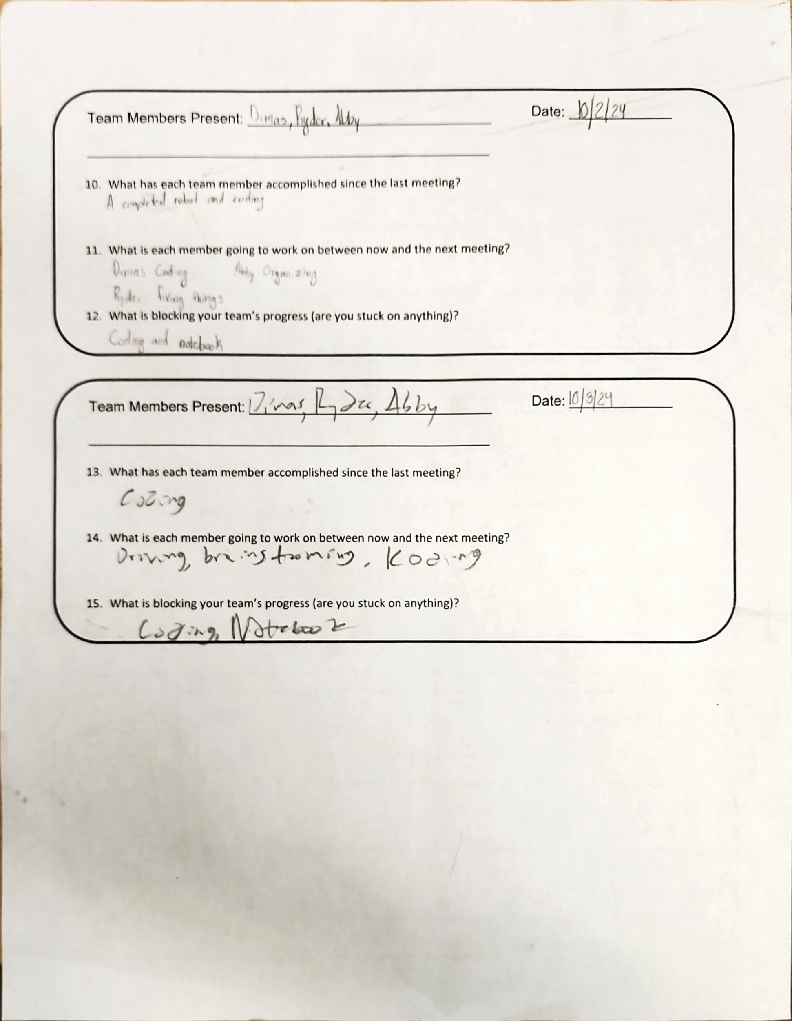
Project: Scrum Meeting
Name: Abigail Way Date:10/21/24 Page: 31

Slide 39
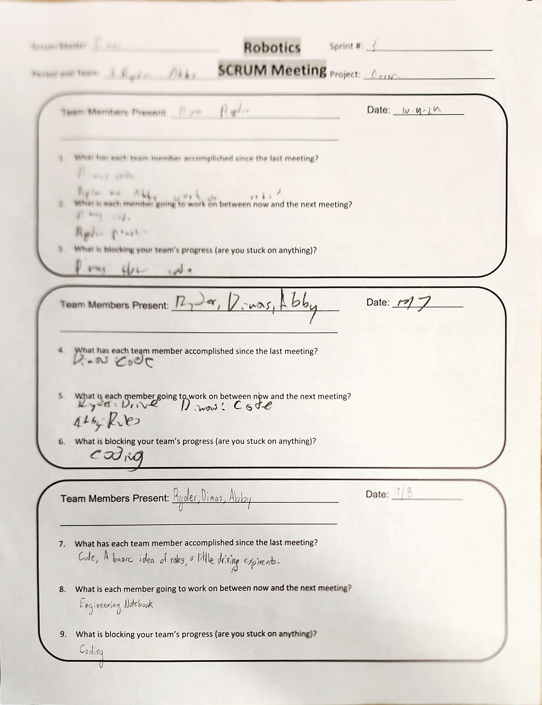
Project: Scrum Meeting
Name: Abigail Way Date:10/21/24 Page: 32

Slide 40
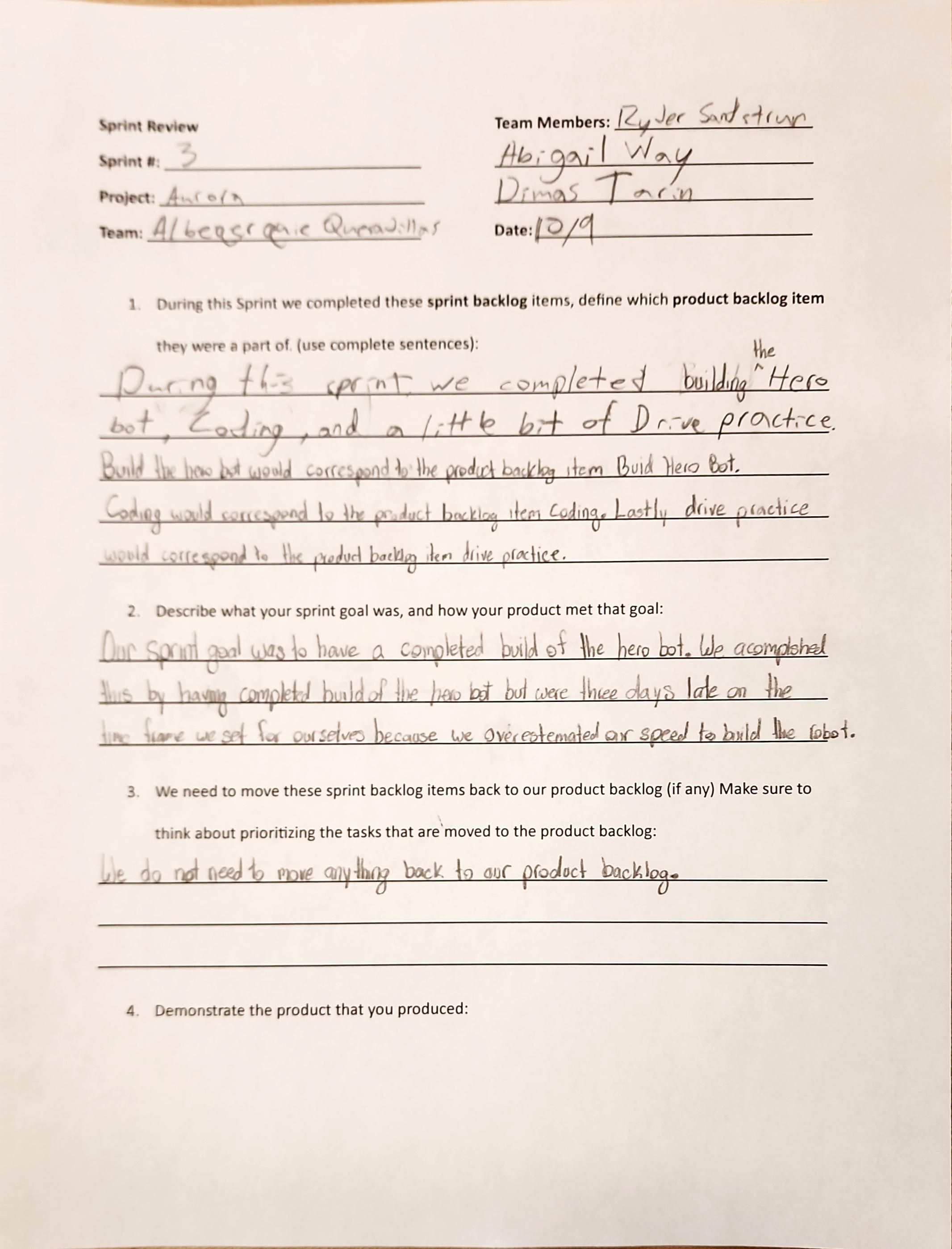
Project: Scrum Review
Name: Abigail Way Date:10/21/24 Page: 33

Slide 41
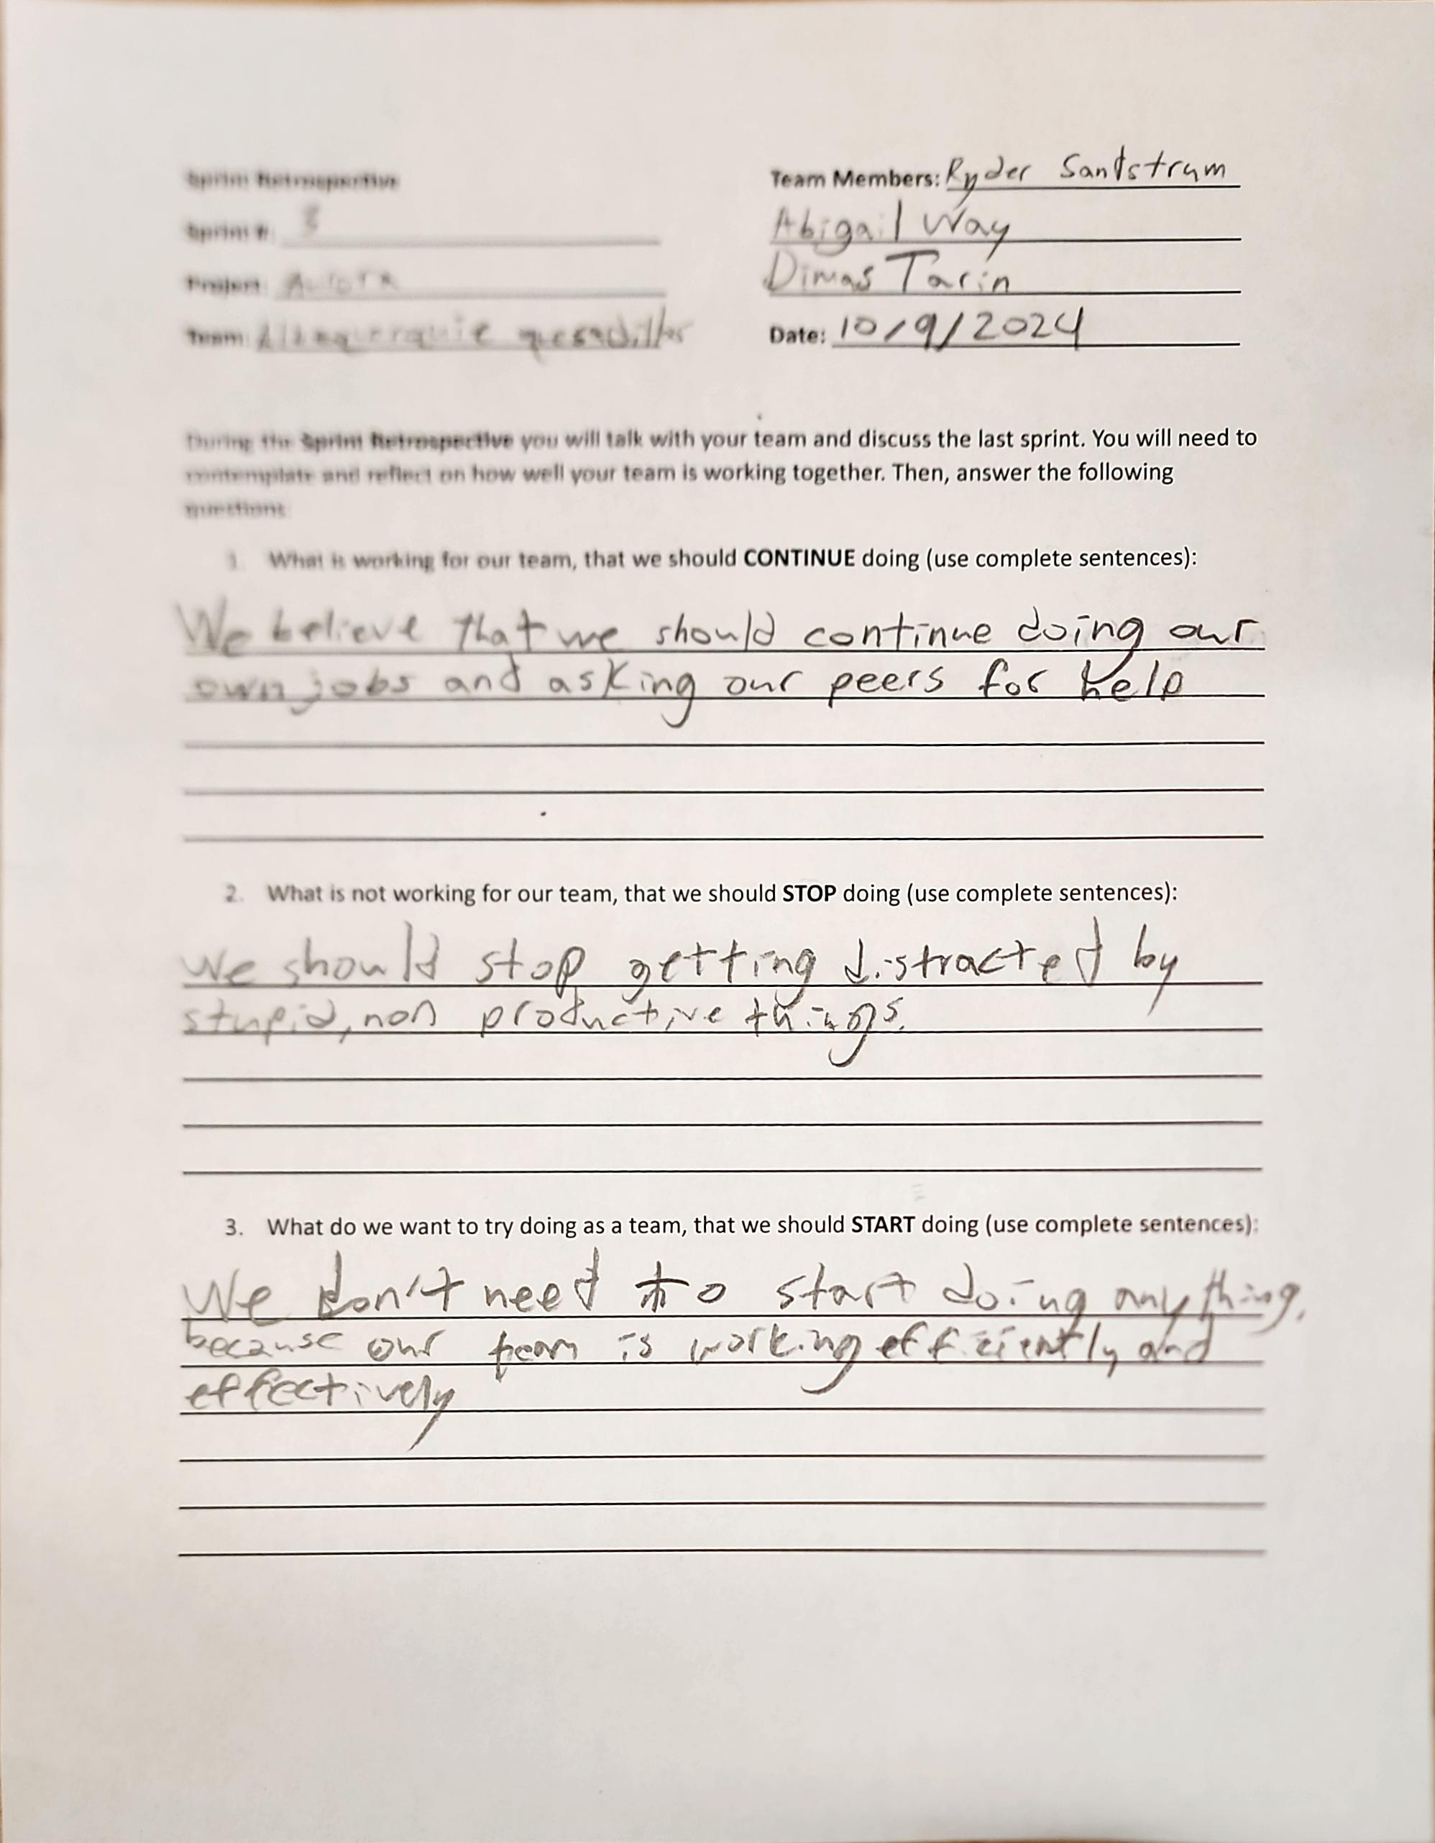
Project: Sprint Retrospective
Name: Abigail Way Date:10/21/24 Page: 34

Slide 42
Sprint Plan
This Sprint we are getting ready for our first competition on November 2. We will need to work on our code for an autonomous period. Along with that we will need to work on our driving skills and getting familiar with the rules.
Abigail Way
10/24/24
25

Slide 43
Scrum Meeting
Scrum Master: Dimas Tarin
Robotics
SCRUM Meeting
Sprint: 3/4
Team Members: Abby, Dimas,
Ryder
Project: Aurora
Team Members Present: Abby, Dimas, Ryder
Date: 10/11/24
What has each team member accomplished since the last meeting?
We have accomplish a basic code, a sense of driving, and the rules.
What is each team member going to work on between now and the next meeting?
Ryder: Drive
Dimas: Code
Abby: Engineering Notebook
What is blocking your team’s progress (are you stuck on anything)?
Our code is blocking our team’s progress.
Team Members Present: Abby, Dimas, Ryder
Date: 10/21/24
What has each team member accomplished since the last meeting?
We have accomplish a basic code, a sense of driving and a competition ready engineering notebook.
What is each team member going to work on between now and the next meeting?
Ryder: Drive
Dimas: Code
Abby: Engineering Note
What is blocking your team’s progress (are you stuck on anything)?
Our code is blocking our team’s progress.
Abigail Way
10/21/24

Slide 44
Scrum Meeting
Scrum Master: Dimas Tarin
Robotics
SCRUM Meeting
Sprint: 3/4
Team Members: Abby, Dimas,
Ryder
Project: Aurora
Team Members Present: Abby, Dimas, Ryder
Date: 10/22/24
What has each team member accomplished since the last meeting?
We have accomplish a basic code, a sense driving, and a competition ready engineering notebook.
What is each team member going to work on between now and the next meeting?
Ryder: Drive
Dimas: Code
Abby: Engineering notebook
What is blocking your team’s progress (are you stuck on anything)?
Our code is blocking our team’s progress.
Team Members Present: Abby, Dimas, Ryder
Date: 10/23/2024
What has each team member accomplished since the last meeting?
We have accomplish a basic code, an idea of driving, and a competition ready engineering notebook.
What is each team member going to work on between now and the next meeting?
Ryder: Drive
Dimas: Code
Abby: Get familiar with the rules
What is blocking your team’s progress (are you stuck on anything)?
Our code is blocking our team’s progress.
Abigail Way
10/24/2024

Slide 45
Scrum Meeting
Scrum Master: Dimas Tarin
Robotics
SCRUM Meeting
Sprint: 3/4
Team Members: Abby, Dimas,
Ryder
Project: Aurora
Team Members Present: Abby, Dimas, Ryder
Date:10/24/24
What has each team member accomplished since the last meeting?
We have accomplish a basic code, an idea of driving, and a competition ready engineering notebook.
What is each team member going to work on between now and the next meeting?
Ryder: Dive practice
Dimas: Code
Abby: Read the game manual
What is blocking your team’s progress (are you stuck on anything)?
Our code is blocking our team’s progress.
Team Members Present: Abby, Dimas, Ryder
Date: 10/25/24
What has each team member accomplished since the last meeting?
We have accomplish a basic code, an idea of driving, and a competition ready engineering notebook.
What is each team member going to work on between now and the next meeting?
Ryder: Drive
Dimas: Code
Abby: Read game manual
What is blocking your team’s progress (are you stuck on anything)?
Our code is blocking our team’s progress.
Abigail Way
10/24/2024

Slide 46
Scrum Master: Dimas
Robotics
SCRUM Meeting
Sprint: 4
Team Members: Abby, Dimas,
Ryder
Project:
Team Members Present: Abby, Dimas, Ryder
Date: 10/28/24
What has each team member accomplished since the last meeting?
We have accomplish a completed basic code, a sense of driving and rules.
What is each team member going to work on between now and the next meeting?
Ryder: Drive
Dimas: Code
Abby: Read rules
What is blocking your team’s progress (are you stuck on anything)?
Our code is blocking our team’s progress.
Team Members Present: Abby, Dimas, Ryder
Date:
What has each team member accomplished since the last meeting?
We have accomplish a
What is each team member going to work on between now and the next meeting?
Ryder:
Dimas:
Abby:
What is blocking your team’s progress (are you stuck on anything)?
Our code is blocking our team’s progress.

Slide 47
Scrum Master:
Robotics
SCRUM Meeting
Sprint:
Team Members:
Project:
Team Members Present: Abby, Dimas, Ryder
Date:
What has each team member accomplished since the last meeting?
We have accomplish a
What is each team member going to work on between now and the next meeting?
Ryder:
Dimas:
Abby:
What is blocking your team’s progress (are you stuck on anything)?
Our code is blocking our team’s progress.
Team Members Present: Abby, Dimas, Ryder
Date:
What has each team member accomplished since the last meeting?
We have accomplish a
What is each team member going to work on between now and the next meeting?
Ryder:
Dimas:
Abby:
What is blocking your team’s progress (are you stuck on anything)?
Our code is blocking our team’s progress.

Slide 48
Scrum Master:
Robotics
SCRUM Meeting
Sprint:
Team Members:
Project:
Team Members Present: Abby, Dimas, Ryder
Date:
What has each team member accomplished since the last meeting?
We have accomplish a
What is each team member going to work on between now and the next meeting?
Ryder:
Dimas:
Abby:
What is blocking your team’s progress (are you stuck on anything)?
Our code is blocking our team’s progress.
Team Members Present: Abby, Dimas, Ryder
Date:
What has each team member accomplished since the last meeting?
We have accomplish a
What is each team member going to work on between now and the next meeting?
Ryder:
Dimas:
Abby:
What is blocking your team’s progress (are you stuck on anything)?
Our code is blocking our team’s progress.

Slide 49
Scrum Master:
Robotics
SCRUM Meeting
Sprint:
Team Members:
Project:
Team Members Present: Abby, Dimas, Ryder
Date:
What has each team member accomplished since the last meeting?
We have accomplish a
What is each team member going to work on between now and the next meeting?
Ryder:
Dimas:
Abby:
What is blocking your team’s progress (are you stuck on anything)?
Our code is blocking our team’s progress.
Team Members Present: Abby, Dimas, Ryder
Date:
What has each team member accomplished since the last meeting?
We have accomplish a
What is each team member going to work on between now and the next meeting?
Ryder:
Dimas:
Abby:
What is blocking your team’s progress (are you stuck on anything)?
Our code is blocking our team’s progress.

Slide 50
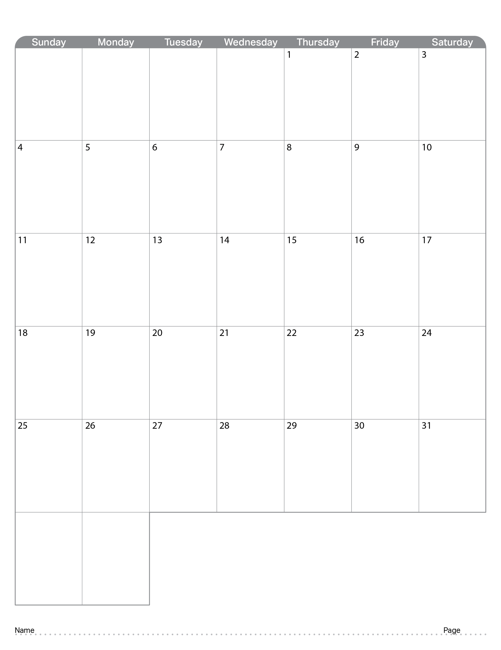
August 2024
 |  | Went through Engineering Notebook | Started coming up with robot ideas | Worked on first conveyor belt prototype as well as watching a video about award winning Engineering Notebook. | Worked on base by taking apart claw bot as well as scrum test
Abigail Way
36

Slide 51

September 2024
 | NO SCHOOL | NO SCHOOL | Worked on base | Continue to work on base and drawings. | Continue to work on base and drawings.
 | Sprint Retrospective, and Sprint Review | Started Sprint 2 | Continued working on base, 3D modeling, and updated Notebook | Coding, Updated Notebook, Continued working on base | Continued working on base, 3D modeling, and updated Notebook
 | Continued working on base, 3D modeling, and updated Notebook | Coding, Updated Notebook, Continued working on base | Continued working on base, 3D modeling, and updated Notebook | Coding, Updated Notebook, Continued working on base | Continued working on base, 3D modeling, and updated Notebook
 | Continued working on base, 3D modeling, and updated Notebook | Coding, Updated Notebook, Continued working on base | Continued working on base, 3D modeling, and updated Notebook | Coding, Updated Notebook, Continued working on base | Continued working on base, 3D modeling, and updated Notebook
 | Continued working on base, 3D modeling, and updated Notebook
Abigail Way
37

Slide 52

October 2024
 |  | Code | Code | Code | Code
 | Code | Code, Drive, get a sense of rules | Code, Drive, get a sense of rules | Half Day No Class | Half Day Code, Drive, Engineering Notebook
 | No School | No School | No School | No School | No School
 | Code, Drive, Engineering Notebook | Code, Drive, get a sense of rules | Code, Drive, get a sense of rules
Abigail Way
38

Slide 53

November 2024
 |  |  |  |  | No School
 | No School | No School | No School | No School | No School

Slide 54

December 2024
 | No School | No School | No School | No School | No School
 | No School | No School | No School | No School | No School
 | No School | No School

Slide 55

January 2025
 |  |  | No School | No School | No School
 | No School
 | No School

Slide 56

February 2025
 |  |  |  |  | No School
 | No School

Slide 57

March 2025
 |  |  |  | Half Day | Half Day
 | No School | No School | No School | No School | No School

Slide 58

April 2025
 |  |  |  |  | No School

Slide 59

May 2025

Slide 60

Resources
engineering.vex.com
notebooking.vex.com
coding.vex.com
Judging Rubric for Notebooks
vex.com
roboticseducation.org
V5RC 2024-2025 Game - Rules & Game Video
Send suggestions and comments about these Digital Notebooks and Digital Parts
to notebooks@vex.com

